Slide 1

REUSO POTAVEL DE AGUAS RESIDUAIS:
O MERCADO GLOBAL ATUAL
E O PAPEL DOS PROCESSOS DE OXIDAÇÃO AVANÇADA
Jose C Fragoso
10 Dezembro 2015

Slide 2

Empresa
SOLUÇÕES INOVADORAS PARA TRATAMENTO DE ÁGUA
> 500 colaboradores, operando a partir de 25 localidades em 12 paises
$200M em vendas anuais
5.0% investidos em pesquiza e desenvolvimento
Mais de 8,000 instalações municipais em 6 continentes
Representantes: mais de 200 escritórios em 90 paises nos
6 continentes
Manufatura no Canada, USA, Europa e China
Notes:
8,000 muni installs includes Salsnes

Slide 3






Unidades de Negócios
Através de aquisições e parcerias estratégicas, a empresa tem diversificado seu portfolio de produtos e aplicações. Trojan Technologies é composta por seis unidades de negócios:
UV disinfection systems for industrial and commercial water and wastewater treatment
Solids separation for municipal, commercial and industrial wastewater
UV disinfection and UV-oxidation systems for municipal water and wastewater treatment
Filtration + UV treatment systems for ballast water
Environmental hydrogen peroxide-based treatment programs to purify water, wastewater, soil and air
UV disinfection systems for homes and businesses

Slide 4



























DANAHER
Environmental
Test &
Measurement
Dental
Life Sciences
& Diagnostics
Industrial
Technologies
Water Quality
Communications
Dental
Diagnostics
Product ID
Gilbarco Veeder-Root
Instruments
Life Sciences
Automation
4
Building a Global Science and Technology Company

Slide 5

WATER QUALITY – GLOBAL TRENDS
Contaminants are being detected
regularly in the water supply
Many regulators are now requiring routine testing of chemicals that were virtually unknown just a few years ago (e.g. nitrosamines by California DPH & UCMR 2)
Supplies are tightening as population increases and water sources are more heavily tapped
Unintentional water reuse is occurring
“One city’s wastewater is another city’s drinking water”
Notes:
These are macro-trends that are affecting water utilities
We are looking for, and finding more and more contaminants are detected in surface water and groundwater
Surface and ground waters used in DW are subject to increasing regulations for contaminants
Increasing population means that more and more wastewater and drinking water are injected into and taken from the same water body respectively
Unintentional reuse refers to drinking water obtained from water sources into which treated wastewater is injected
Example: the Mississippi River or the Great Lakes

Slide 6
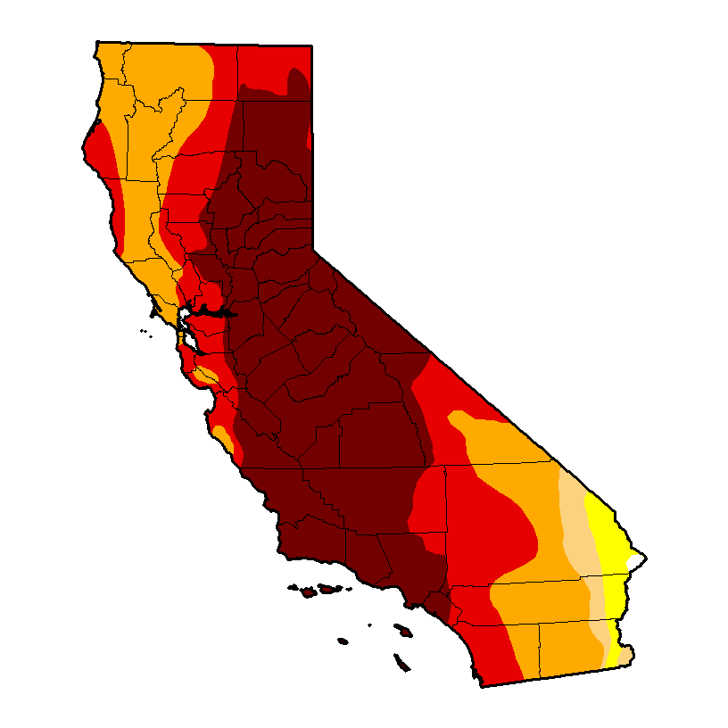
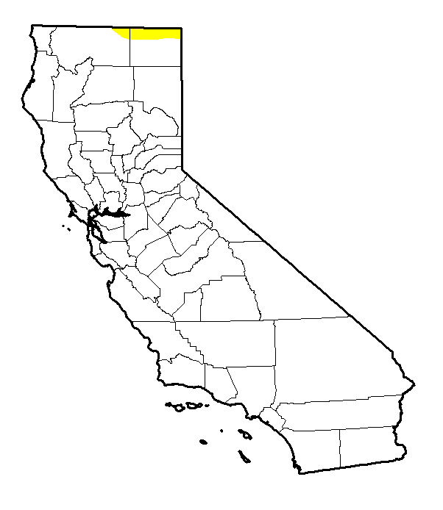
Water Stress IN THE UNITED STATES
California
Southern cities (e.g. Los Angeles and San Diego) receive the bulk of their water from the Colorado river and from the northern part of the state
  Extreme costs associated with transportation
  20% of energy used in state is used to move water
Title 22 provides guidelines on non-potable reuse treatment requirements
Guidelines on potable reuse expected in 2016.
As of August 6, 2015
Source: U.S. Drought Monitor (University of Nebraska, Lincoln), 2015
Notes:
Recent drought conditions in Texas has impacted the quantity of fresh water available in the state
This figure represents drought conditions in the state of Texas as of February 28, 2012
Areas in Red represent EXTREME DROUGHT
Areas in Dark Red represent EXCEPTIONAL DROUGHT
In addition, California relies heavily on the transport of drinking water from its northern territories to cities like Los Angeles which do not have significant amounts of fresh water
Driver for IPR
Water stress is not the only driver for IPR

Slide 7
Water Stress IN THE UNITED STATES
California
Southern cities (e.g. Los Angeles and San Diego) receive the bulk of their water from the Colorado river and from the northern part of the state
  Extreme costs associated with transportation
  20% of energy used in state is used to move water
Title 22 provides guidelines on non-potable reuse treatment requirements
Guidelines on potable reuse expected in 2016.
As of July 26, 2005
Source: U.S. Drought Monitor (University of Nebraska, Lincoln), 2015
Notes:
Recent drought conditions in Texas has impacted the quantity of fresh water available in the state
This figure represents drought conditions in the state of Texas as of February 28, 2012
Areas in Red represent EXTREME DROUGHT
Areas in Dark Red represent EXCEPTIONAL DROUGHT
In addition, California relies heavily on the transport of drinking water from its northern territories to cities like Los Angeles which do not have significant amounts of fresh water
Driver for IPR
Water stress is not the only driver for IPR

Slide 8
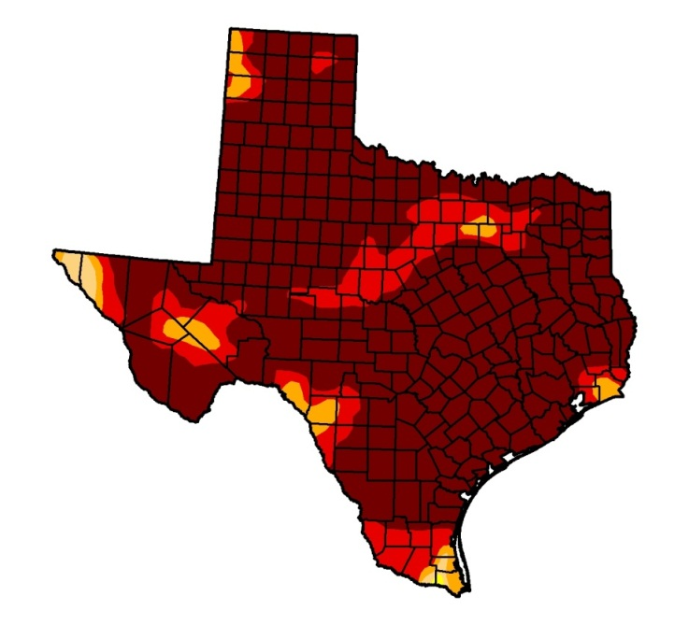
Water Stress IN THE UNITED STATES
Texas
Extreme drought conditions caused strain on drinking water sources
As of February 28, 2012
Source: U.S. Drought Monitor (University of Nebraska, Lincoln), 2012
Notes:
Recent drought conditions in Texas has impacted the quantity of fresh water available in the state
This figure represents drought conditions in the state of Texas as of February 28, 2012
Areas in Red represent EXTREME DROUGHT
Areas in Dark Red represent EXCEPTIONAL DROUGHT
In addition, California relies heavily on the transport of drinking water from its northern territories to cities like Los Angeles which do not have significant amounts of fresh water
Driver for IPR
Water stress is not the only driver for IPR

Slide 9
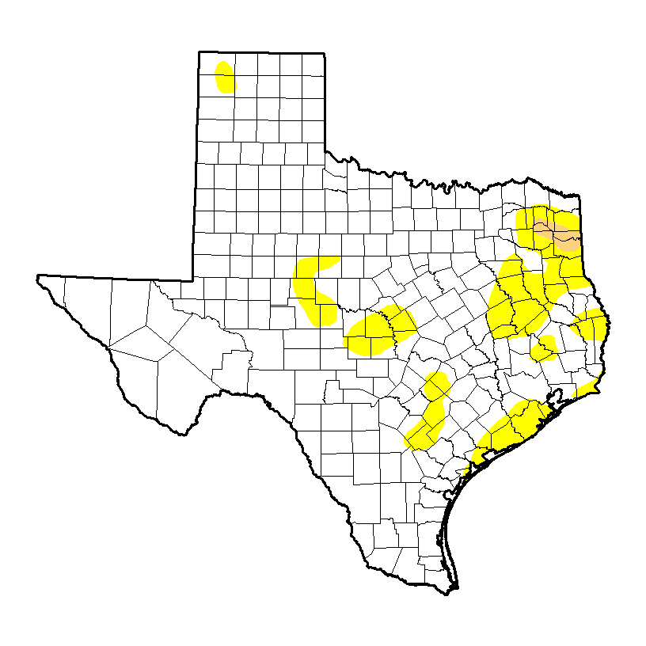
Water Stress IN THE UNITED STATES
Texas
Most recent State Water Plan released in 2012
Composed of 16 individual water planning regions which submit long-term water plans to the Texas Water Development Board (TWDB) in advance of State Water Plan developments.
As of July 28, 2015
Source: U.S. Drought Monitor (University of Nebraska, Lincoln), 2012
Notes:
Recent drought conditions in Texas has impacted the quantity of fresh water available in the state
This figure represents drought conditions in the state of Texas as of February 28, 2012
Areas in Red represent EXTREME DROUGHT
Areas in Dark Red represent EXCEPTIONAL DROUGHT
In addition, California relies heavily on the transport of drinking water from its northern territories to cities like Los Angeles which do not have significant amounts of fresh water
Driver for IPR
Water stress is not the only driver for IPR

Slide 10
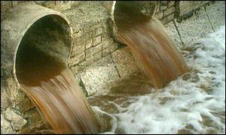
Water stress: what are the options?
Reduce Growth
Conserve
Develop New Water Sources
Water Transfer
Desalination
  Seawater
  Brackish Water
Non-potable Reuse to Offset DW
Indirect or Direct Potable Reuse (IPR/DPR)
Notes:
What does a community do when its looking to augment water supplies?
Here is a list of some of these solutions
Move water from somewhere else – costly, significant infrastructure required
Offset drinking water use for irrigation, toilet flushing, etc. – “purple pipe”
“Make” new water from desal or reuse
Different cost and energy implications for all

Slide 11
Water Shortage: what are the options?
IPR is also less energy intensive than other water shortage solutions
IPR is an Attractive Option Both in Terms of:
  Costs
  Energy Use
ENERGY
IPR/DPR = 75% Less Energy than Desalination
Notes:
As mentioned previously, sea-water can be desalinated to become drinking water, BUT this is an energy intensive process
Alternative, the use of indirect potable reuse (IPR) potentially used 75% less energy and results in significant cost savings
Why: lower feed pressure in RO leads to lower energy requirement to move water thru RO membranes
Also: brine associated with seawater RO discharge is much more significant than that produced by IPR/DPR

Slide 12
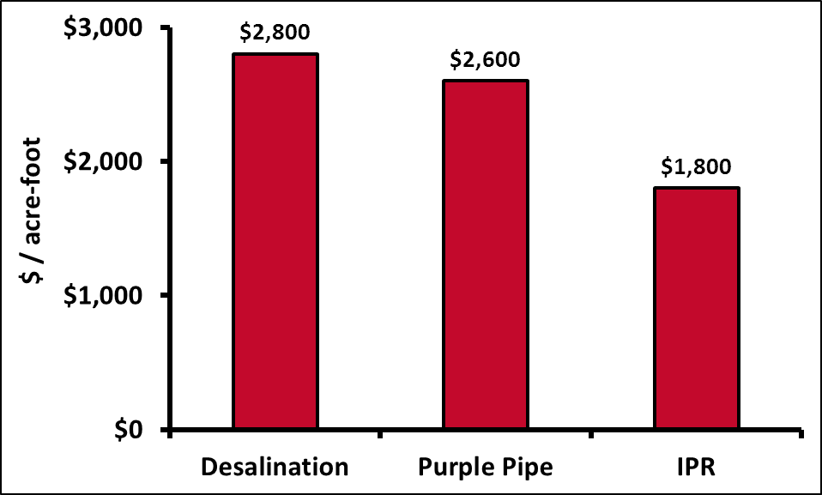
Water stress: what are the options?
IPR is cheaper than desalination and non-potable water reuse
  Desal: Higher energy costs
  Non-potable (Purple Pipe): Install new distribution system
Fermian Business and Economic Institute, 2011
Notes:
This analysis shows the $/acre-foot for three well recognized methods for conserving drinking water supplies
This analysis was done for the city of San Diego
Desalination costs are generally higher to the extremely high energy requirements. In addition, there are always debates about the disposal of the RO brine
Purple pipe is a term used to describe the reuse of wastewater for non-potable purposes such as water golf courses and agricultural irrigation.
Purple pipe systems always require the installation of an exclusive distribution system for the reused water this can cost millions of dollars for each mile of pipe
In this analysis, the IPR cost includes the cost of transporting advanced treated wastewater ~10 miles to a reservoir for storage. Therefore, IPR cost shown here is slightly higher than what would be for equivalent large projects with a smaller transportation requirement.

Slide 13
UV for Disinfection

Slide 14
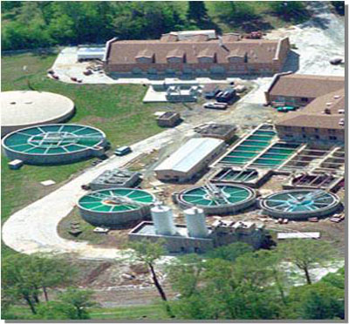
METHODS OF DISINFECTION
Chlorine
  Chlorine Gas
  Sodium Hypochlorite (Bleach)
  Chlorine Dioxide
Ozone (O₃)
Membrane filtration
UV Disinfection
Notes:
There are a number of technologies used for disinfection
UV is the subject of this presentation

Slide 15
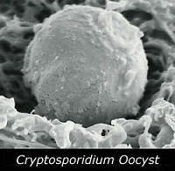
WHY DISINFECT? CRYPTOSPORIDIUM
Milwaukee, WI 1993 – 403,000 sick, 104 deaths
  largest documented waterborne disease outbreak in US history
  There was contamination present and a high turbidity event at the Howard Avenue Water Purification Plant
  Source of Crypto according to CDC: a wastewater plant 2 miles upstream in Lake Michigan
Notes:
The Milwaukee Crypto outbreak of March 23 through April 8, 1993, sickened 403,000 of an estimated 1.61 million residents in the Milwaukee area, with stomach cramps, fever, diarrhea and dehydration caused by the pathogen
The Howard Avenue Water Purification Plant was contaminated, and treated water showed turbidity levels well above normal
It was one of two water treatment plants for Milwaukee
The cause of epidemic was never officially identified. However the CDC showed that this outbreak was caused by cryptosporidium oocysts that passed through the filtration system of one of the city's drinking water treatment plants, arising from a sewage treatment plant's outlet 2 miles upstream in Lake Michigan

Slide 16
WHY DISINFECT? CRYPTOSPORIDIUM
Cryptosporidium – parasite that can live inside the intestines of humans/farm and wild animals/pets
  Forms protective shell (an oocyst) that enables it to live in harsh conditions
Cryptosporidiosis symptoms: stomach cramps, fever, diarrhea, dehydration
Resistant to chlorine
Notes:
Crypto is not well removed by filtration, conventional treatment, or chemical disinfection
The protective shell, the oocyst, makes it very hearty and difficult to inactivate by conventional methods
The oocyst can remain in the intestines of humans and farm animals, which is why it can be more readily detected in WTPs with watersheds that contain cattle
However, despite best watershed protection efforts, crypto can still be detected
You may have followed the story of Portland Oregon
which did not detect Crypto in water from their Bull Run protected watershed during years of monitoring, but then had a detection in Dec 2011
This event occurred during the time that they were being considered for a treatment waiver for their unfiltered system
Poor timing
However, they ultimately got that waiver despite the Crypto detections and they are not building the planned UV plant, but it highlights the potential for Crypto in just about any watershed

Slide 17
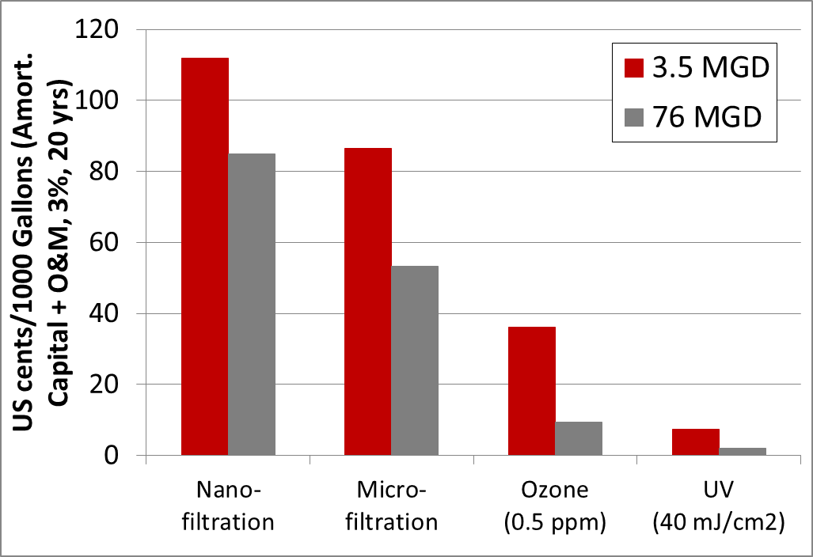

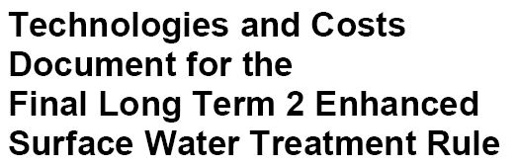
DISINFECTION COSTS – UV IS HIGHLY COST-EFFECTIVE
UV is 1/5th cost of ozone
UV is 1/10th the cost of membranes
Implementation of log-reduction treatment leading to even lower UV costs
Notes:
These costs are summarized in The EPA Office of Water’s 2005 LT2 cost report
The study was extremely comprehensive
The plot above is shows that UV is significantly cheaper than alternate disinfection technologies
This analysis was done assuming a dose or 40 mJ/cm2, which, in EPA sizing methodologies, is rarely achieved
Lower doses resulting from targeted log reductions (e.g. 2-log crypto dose of 5.8 mJ/cm2) would result in lower UV costs if this analysis was rerun for a typical plant today
The EPA summarizes how they got to this comparison in the following paragraph (FYI):
To compare technologies’ cost to one another, it is helpful to annualize the capital costs and add
them to the O&M costs to obtain an average annual expenditure for each technology. The annualization
is done according to the methodology described in section 4.3. Expressing the annualized costs in cents
per thousand gallons allows costs to be expressed in similar units for all size plants so economies of scale
and other factors can be seen. Exhibit 4.55 [summarized in plot above] shows the annualized cost for each of the technologies
discussed above for all size ranges. Costs are annualized using a three percent discount rate over a twenty
year period, which is the assumed lifetime of the equipment.

Slide 18
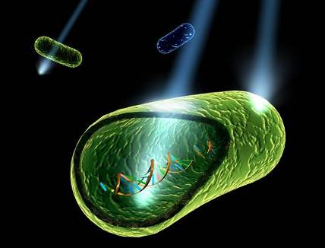
HOW DOES UV DISINFECT?
UV light penetrates the cell wall
The UV energy permanently alters the DNA structure of the microorganism
The microorganism is “inactivated” and unable to reproduce or infect
Cell Wall
DNA Nucleic Acid
Notes:
How does chlorine disinfection work?
Chlorine kills pathogens such as bacteria and viruses by breaking the chemical bonds in their molecules
This requires time for the cell wall to be broken down
This requires contact chambers and time which require footprint
UV disinfects virtually instantaneously

Slide 19
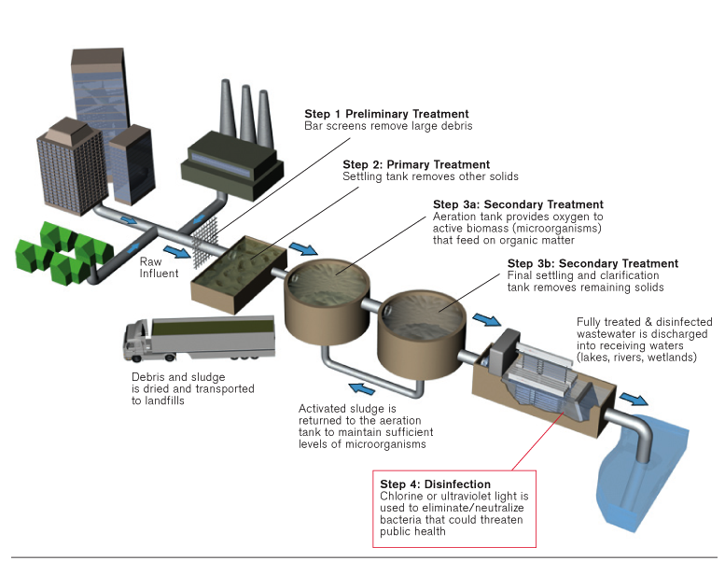
WASTEWATER DISINFECTION
Notes:
So where does UV disinfection fit into a typical WWTP?
This slide shows a typical WWTP with secondary treatment and UV disinfection (or other disinfectant) is applied at the end of the process to effect final destruction of
Bacteria, etc. In a re-use application there is typically additional tertiary treatment followed by UV disinfection.

Slide 20
Examples of UV Installations Large and Small

Slide 21
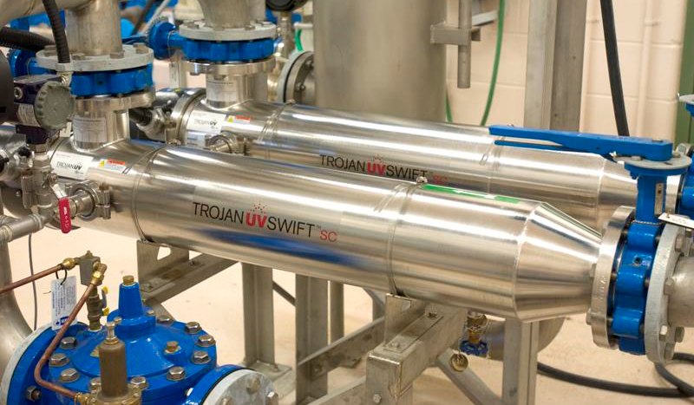
NEUSTADT, ONTARIO CANADA – TROJANUV SWIFT™ SC
Notes:
A relatively small disinfection system in Ontario, Canada
TrojanUVSwift™SC B04

Slide 22
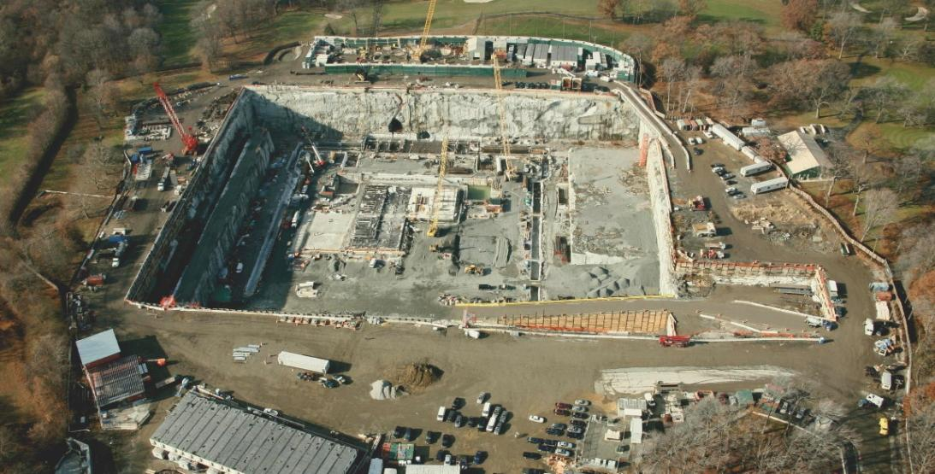
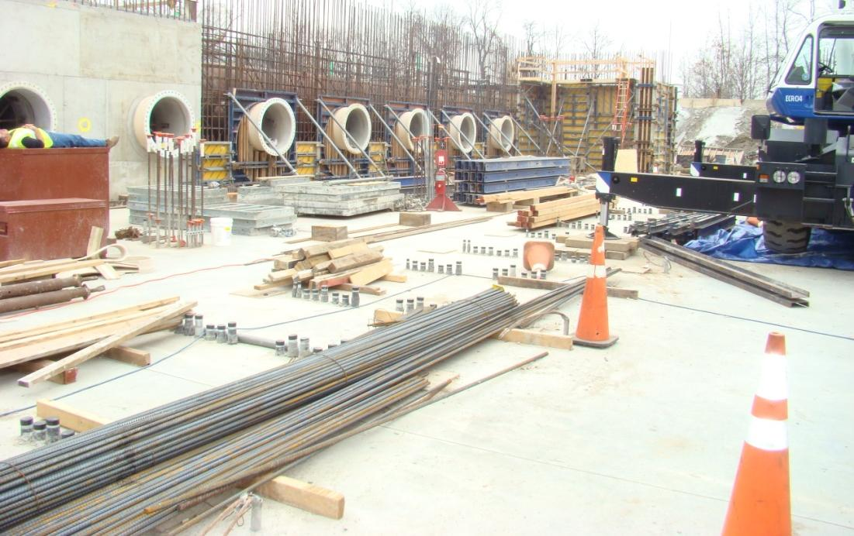
New York City - TROJANUVTORRENT™
Notes:
Construction is just about complete on the UV disinfection system in NYC as of early 2012
Startup mid 2012
This is the Cat Del plant, one of two (the other is Croton)
Shown are the large, 48” headers for the UV system trains

Slide 23
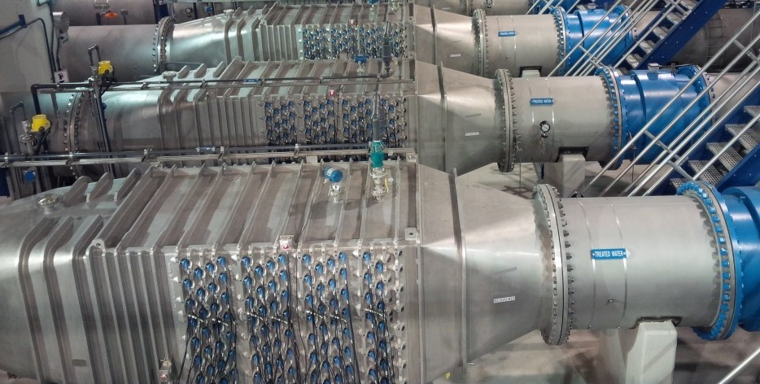
New York City – One quadrant, 14 Reactors
23
Notes:
The TrojanUVTorrent™ for NYC Cat Del
Rendering showns a portion of the 56 trains
Each reactor is sized to treat 40 MGD/train
Total flow rate of 2.2 BGD

Slide 24
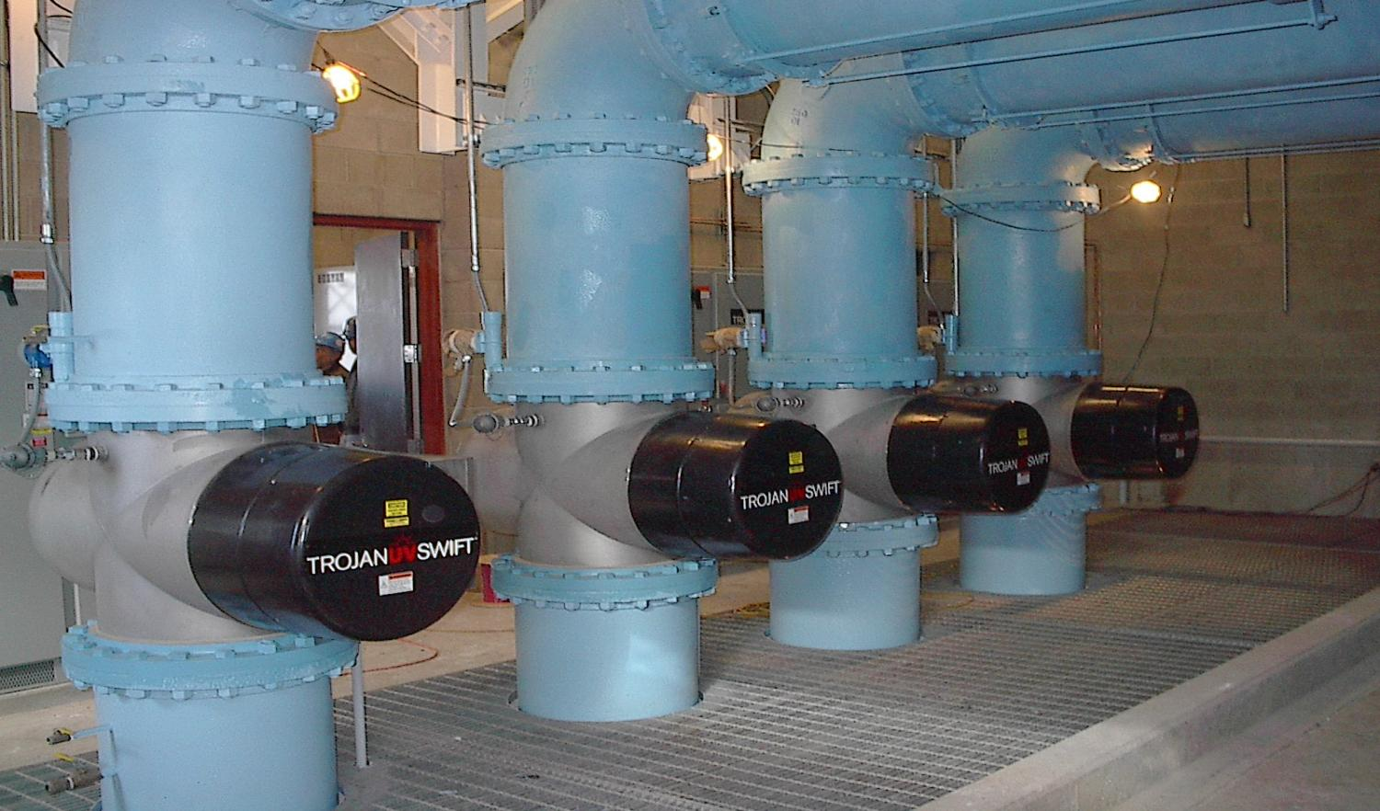
ALBANY, NEW YORK – TROJANUVSWIFT™
Notes:
This is a TrojanUVSwift™ site, and early NA installation, at Albany NY
Vertical configuration

Slide 25
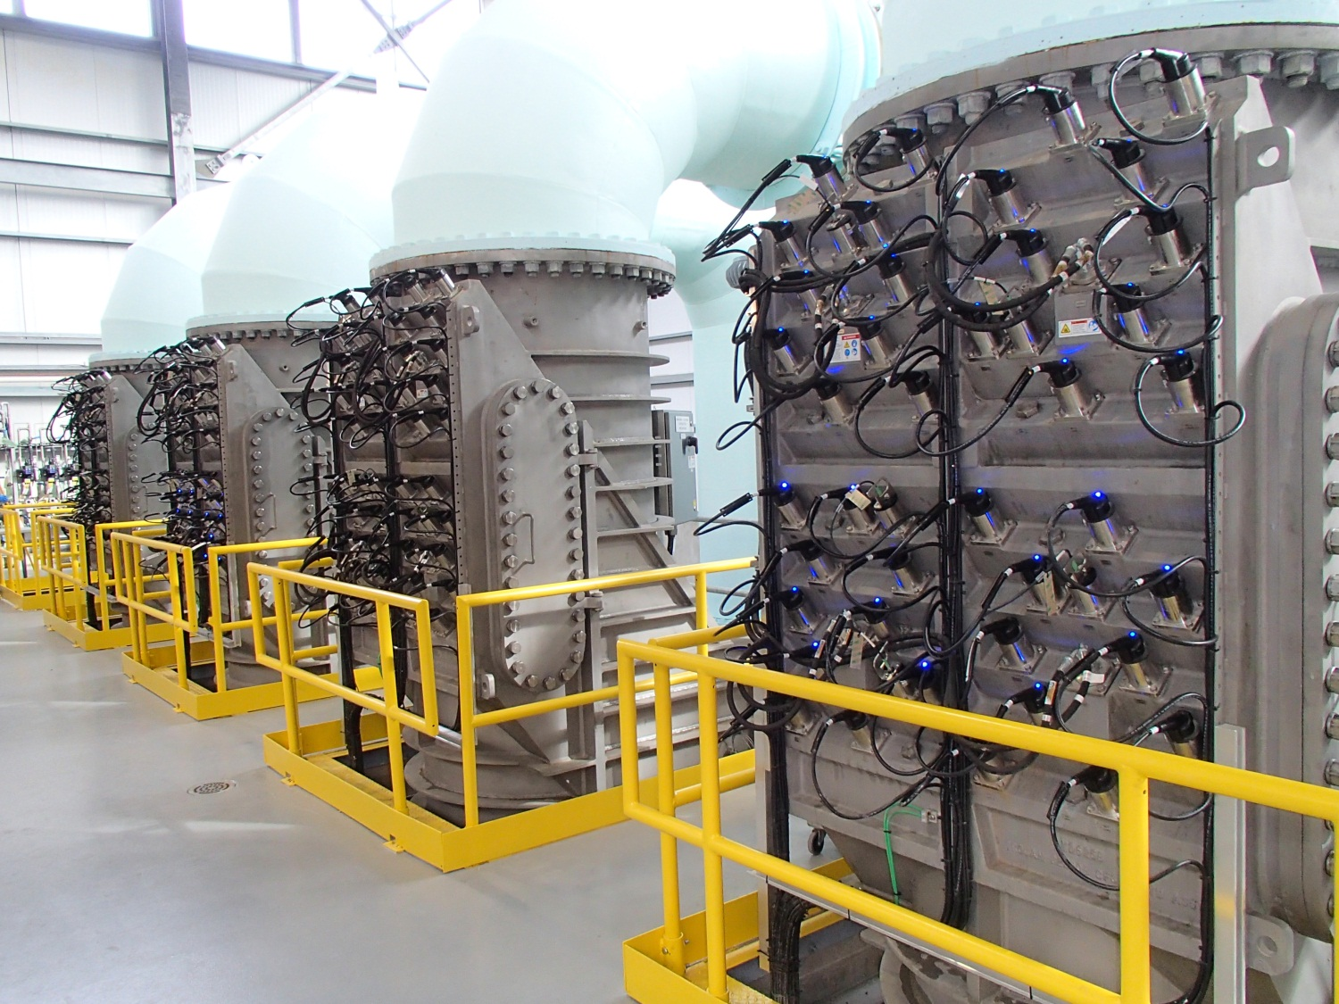
Vancouver, british columbia
Notes:
The TrojanUVTorrent™ for NYC Cat Del
Rendering showns a portion of the 56 trains
Each reactor is sized to treat 40 MGD/train
Total flow rate of 2.2 BGD

Slide 26
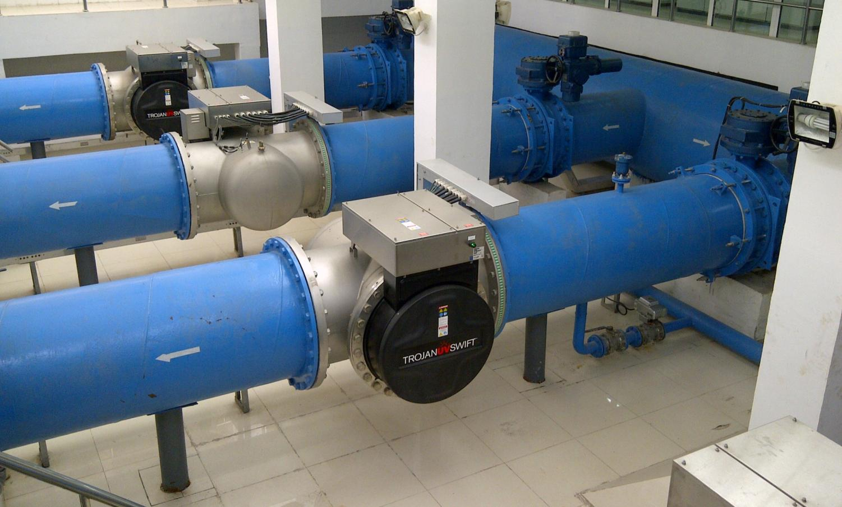
TIANJIN, CHINA – TROJANUVSWIFT
Notes:
This is the first UV system for MDW in China
Tianjin Economic Development Area (TEDA) in Tianjin Province
Between Shanghai and Beijing
TrojanUVSwift™ 6L30 reactors

Slide 27
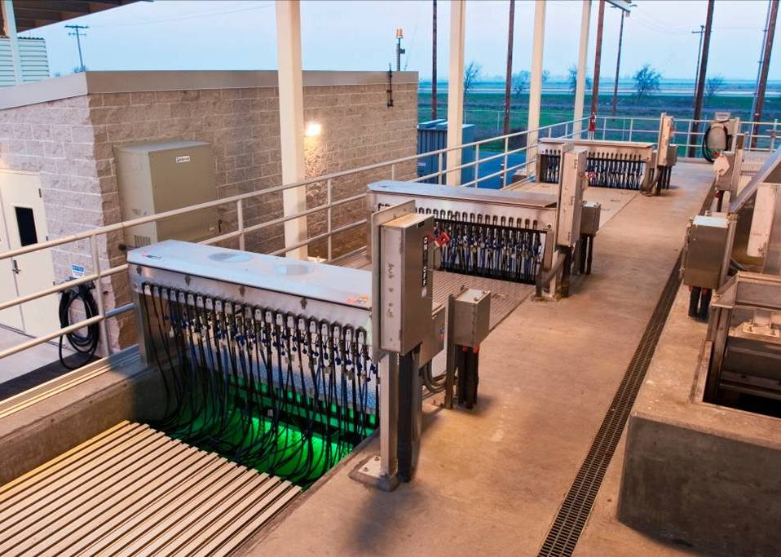

Lodi, California – 714 L/s (16.3 MGD)
TrojanUV3000Plus™
Notes:
This site is located near Napa, CA
Can explain that the reuse regulations in California are stringent and require that multiple UV banks are placed in series to provide redundancy and ensure proper mixing and disinfection performance.
Validation important to ensure system sized appropriately.

Slide 28
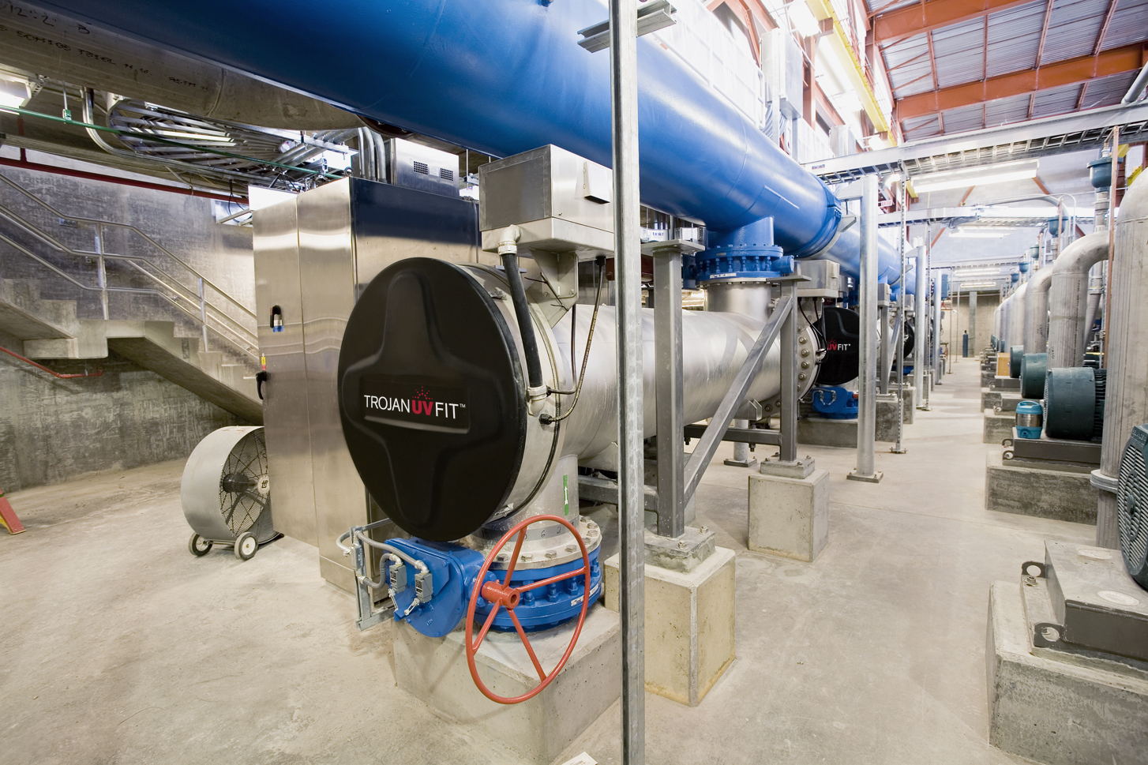
UVFit_ Torrevieja, SPAIN
Peoria, Arizona – 900 L/s (20.5 MGD)
TORREVIEJA Spain – 15.9 MGD (2500 m³/hr)
Wastewater Reuse - TrojanUVFitTM
TrojanUVFit™
Notes:
Closed vessel systems allow plants to pipe in effluent directly from MBR.

Slide 29
UV for Contaminant Treatment

Slide 30
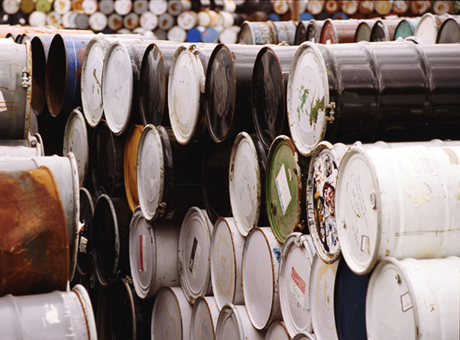

EXAMPLES OF CONTAMINANTS
N-nitrosodimethylamine (NDMA)
Industrial additive & disinfection byproduct
1,4-Dioxane
Industrial solvent
Pesticides & Herbicides
Agricultural crop protection products
Taste & Odor Compounds
Seasonal occurrences of MIB, geosmin and others
Pharmaceuticals & Personal Care Products
Includes potential endocrine disruptors
Notes:
These are key contaminants detected in water
UV-oxidation is effective for each of these contaminants and contaminant groups
NDMA is spoken about in greater detail in the section on Water Reuse
US Federal (EPA) regulations are expected to be implemented for NDMA in the next few years

Slide 31
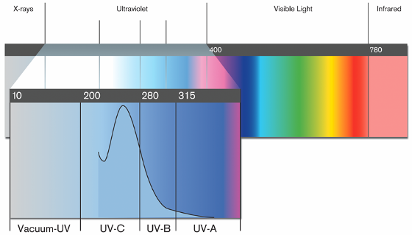
ENVIRONMENTAL CONTAMINANT TREATMENT
Using UV and hydrogen peroxide to destroy trace organic contaminants in water by:
UV-Photolysis
UV-Oxidation
Notes:
UV-Oxidation uses two processes for the treatment of contaminants
UV-Photolysis – UV light alone
UV-Oxidation – UV light + the hydrogen peroxide

Slide 32
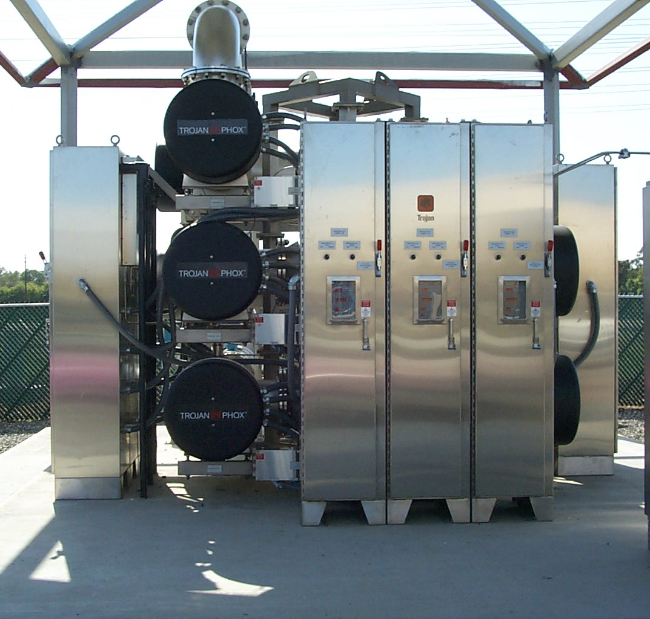
GROWING APPLICATIONS OF UV-OXIDATION FOR ECT
Drinking Water Contaminated groundwater or surface water sources
Indirect/Direct Potable Reuse (IPR) Wastewater treated to drinking water quality
Groundwater Remediation Plume containment, site cleanup
Total Flow Rate for Trojan Municipal UV-Oxidation Projects in
2000: <10 MGD (38 MLD)
2015: >650 MGD (2.5 BLD)
Notes:
Over the last decade, the use of UV for the treatment of chemical contaminants in MUNICIPAL applications has grown significantly
UV-oxidation is used primarily for 3 applications:
Drinking Water: to treat seasonal taste and odor, year round pesticides and wastewater-derived contaminants
Indirect/Potable Reuse: UV-oxidation is a key step in the conversion of wastewater to drinking water
Groundwater Remediation: where unwanted chemicals have entered the water supply
Collectively, these UV-Oxidation projects total, either installed or under contract, 0ver 600 MGD (2.3 billion liters of water a day)

Slide 33
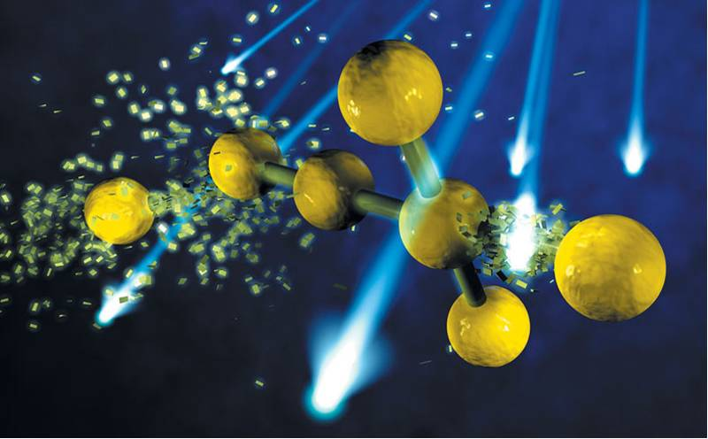
UV-PHOTOLYSIS
Chemical Bonds are
Broken by UV Light
Notes:
UV light is absorbed directly by a contaminant molecule
This absorption leads to the destruction of the chemical bonds of the contaminant

Slide 34
UV-PHOTOLYSIS
UV light is absorbed by the contaminant “C”:
Degradation rate depends on:
  Quantum yield
  Molar absorption coefficients of C in the UV range
  Intensity and spectral distribution of the light source (i.e. lamp type, UV system design)
  Absorption of water background (UVT)
_{C}
hν (energy)
O₂
[radical species]
Products
Notes:
The capacity for a contaminant to be treated through UV-photolysis, by UV light alone, is dependent on:
The amount of UV light used (quantum yield)
How well a contaminant absorbs light in the UV range
Intensity of UV light
UVT
Not all contaminants are able to be treated through UV-photolysis

Slide 35
UV ABSORPTION SPECTRA
UV-Photolysis is highly dependent on a contaminant molecule’s ability to absorb UV light at a certain wavelength
Notes:
This is a plot of the absorbance of UV light by various contaminants
Low-pressure monochromatic light is emitted at 254 nm and at this wavelength you can see that both microcystin (an algal toxin) and NDMA (a carcinogen) absorb light
T&O molecules MIB and Geosmin have low absorbtivity throughout the UVC range and therefore require UV in combination with hydrogen peroxide (UV-Oxidation) for treatment

Slide 36
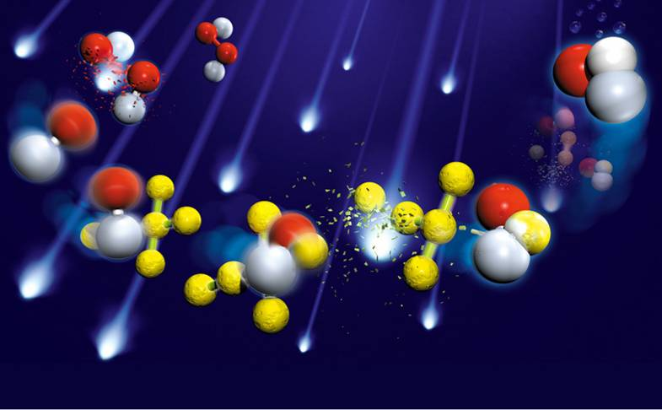
UV-OXIDATION
Hydroxyl
radical
Hydrogen peroxide
Chemical bonds are
broken by hydroxyl
radicals
Notes:
UV light interacts directly with hydrogen peroxide molecules (see red and white molecules in the top-left corner)
Hydrogen peroxide molecules are split into two hydroxyl radical molecules
Contaminant molecules are yellow
The radicals oxidize the contaminant molecule leading to the dissociation of their molecular bonds (see bottom/centre –right of the slide)

Slide 37
UV-OXIDATION REACTION MECHANISMS
UV light is absorbed by hydrogen peroxide:
Degradation rate depends on:
  Intensity and spectral distribution of the light source (i.e. lamp type, UV system design)
  Absorption of water background (UVT)
  Hydroxyl radical (●OH) rate constant k_{OH,C}
  H₂O₂ concentration
  Hydroxyl radical scavenging demand
hν (energy)
H₂O₂
2 •OH
k_{OH,P}
O₂
C + •OH
[radical species]
Products
Notes:
As with UV-photolysis, UV-Oxidation is dependent on the intensity of UV light in the reactor and UVT
The speed at which a contaminant reacts with the hydroxyl radical is quantified by the hydroxyl radical rate constant
Generally, the higher the rate constant, the faster the reaction with the radicals and the more efficient the treatment
The “hydroxyl radical scavenging demand” is the capacity for other constituents in the water scavenge (consume) hydroxyl radicals
Scavenging tends to increase with increasing organic matter, alkalinity, TOC

Slide 38
PHOTOLYSIS + OXIDATION - CONTAMINANT DESTRUCTION BALANCE
6.0
UV Oxidation
UV Photolysis
5.0
4.0
3.0
Contaminant Reduction (relative to NDMA)
UV-Photolysis/UV-Oxidation Contribution to Total
2.0
1.0
0.0
NDMA
Atrazine
Geosmin
Microcystin-LR
Notes:
This table summarizes the balance between UV-oxidation and UV-photolysis
Some contaminants are treated predominantly by UV-Photolysis (e.g NDMA)
Some molecules are treated exclusively through UV-Oxidation (e.g. Geosmin)
MOST contaminant molecules are treated by a combination of both

Slide 39
ECT APPLICATIONS:
POTABLE WATER REUSE
Notes:
The next section of this presentation focuses on applying UV-Oxidation in of potable water reuse applications

Slide 40
INDIRECT POTABLE REUSE SYSTEMS GLOBALLY
Name of Project | Location | Start-Up Date
Orange County Water District Factory 21 | Fountain Valley, CA | 1975
Orange County Water District Groundwater Replenishment System | Fountain Valley, CA | 2004
Leo J. Vander Lans Advanced Treatment Facility | Long Beach, CA | 2003
West Basin Water Recycling Facility | Los Angeles, CA | 2006
Bundamba Advanced Water Purification Facility | Brisbane, AUS | 2007
Luggage Point Advanced Water Purification Facility | Brisbane, AUS | 2008
Gibson Island Advanced Water Purification Facility | Brisbane, AUS | 2008
Joint Water Purification Project | Cottonwood, CO | 2010
San Diego Water Purification Demonstration Project | San Diego, CA | 2011
Big Spring Water Reclamation Facility | Big Spring, TX | 2012
Oxnard Advanced Water Purification Facility | Oxnard, CA | 2012
Notes:
Here is a list of some of the other UV-Oxidation facilities using UV technology for water reuse purposes

Slide 41
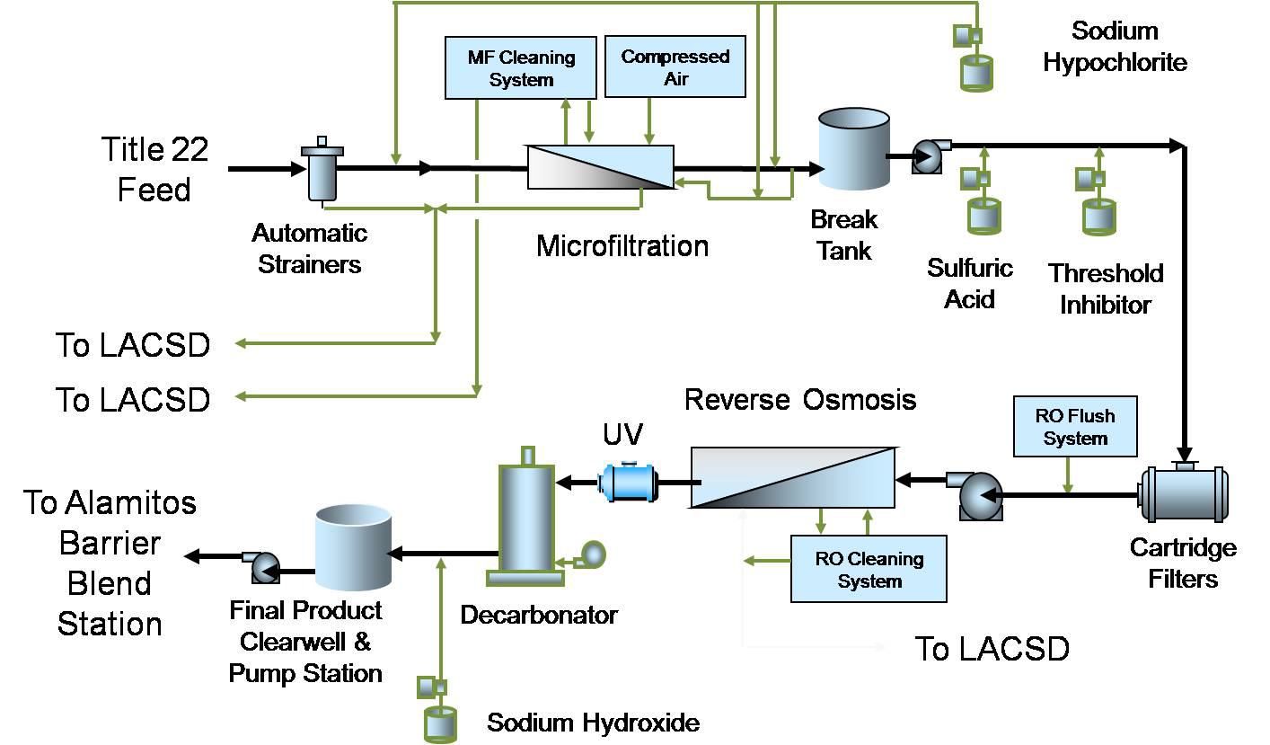
Process Flow Diagram
H₂O₂ or NaOCl

Slide 42
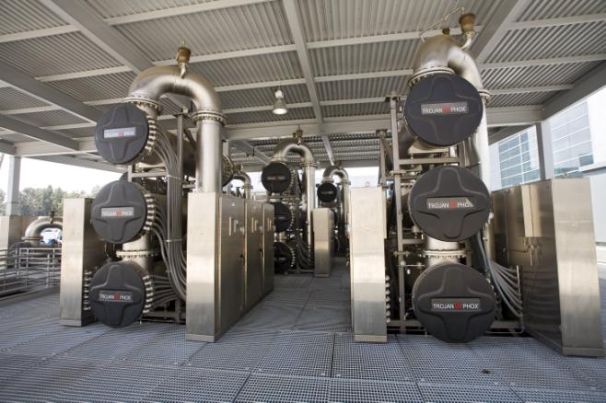
Regulatory Framework
Why oxidation?
  Removal of contaminants that pass through MF and RO
  Up to 6-log virus disinfection
California requires an oxidation step post-RO
  Demonstrated by removing a basket of contaminants or 0.5-log 1,4-dioxane
Texas requires 4-log removal of virus, removal of contaminants

Slide 43
MAKING POTABLE WATER FROM “WASTEWATER”
Water collected from wastewater treatment plants is “advanced” treated to higher standard allowing this water to be treated again back into drinkable water
Advanced treatment includes three different treatment technologies:
    Microfiltration
    Reverse osmosis
    UV-oxidation
Drinking water treatment plant/blending/ environmental buffer
Secondary Wastewater
Microfiltration
RO
UV-Oxidation
Distribution
ADVANCED TREATMENT FACILITY
Notes:
The next slides primarily deal with what is required for the potable reuse of wastewater
When carrying out IPR, a new treatment facility is created to treated secondary wastewater to s standard that allows it to re-enter the DW supply
Emerging regulations suggest that three separate technologies must be used for advanced treatment
The current “gold standard” is to use microfiltration followed by reverse osmosis (RO) followed by UV-Oxidation
After water is treated at the new facility, it is treated again at a drinking water treatment plant before distribution as potable water
January 2012 NWRI White Paper on DPR: “As a result of worldwide population growth, urbanization, and climate change, public water supplies are becoming stressed and tapping new water supplies for metropolitan areas is becoming more difficult, if not impossible. In the future, it is anticipated that DPR will become an imperative (Leverenz et al., 2011).”
Further, recently a white paper written entitled DPR – The Path Forward stated: …”any water quality benefits afforded by the retention of water that has been purified with RO and advanced oxidation in an environmental buffer is minor if any.”
DPR is a beneficial use of recycled water in which supply is located very close to demand – no extensive water distribution networks required.
Also from DPR – The Path Forward: “Current technology is sufficient to replace the environmental buffer with an engineered storage buffer.”
Reduced brine compared to desalination and ¼ the energy requirement

Slide 44
Why USE uv-oxidation FOR IPR?
It has been documented that molecules less than 100 atomic mass units in size and those with high hydrophobicity can pass through microfiltration and RO without being treated
Contaminants with these characteristics include:
NDMA | 1,4-Dioxane
Bisphenol-A | Carbamazepine
DEET | Estradiol
Ibuprofen | Acetaminophen
Clofibric acid | Diclofenac
Meprobamate | Oxybenzone
Notes:
Here is a list of some of the molecular contaminants that can pass through both MF and RO but that are removed by UV-Oxidation
1,4-dioxane and NDMA are human health hazards

Slide 45
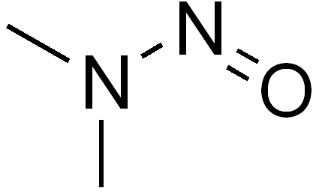
N-NITROSODIMETHYLAMINE (NDMA)
NDMA is a disinfection by-product
It can be generated in both wastewater and drinking water
It is a probable human carcinogen with a 1 in 1,000,000 cancer risk concentration of 0.7 ng/L (ppt) in drinking water
  Source: USEPA Integrated Risk Information System (IRIS) Database
NDMA
Notes:
The next slides focus on NDMA and the removal of NDMA using UV-Oxidation

Slide 46
NDMA – TREATMENT
Ozone
Ineffective for NDMA treatment
Can eliminate the precursors of NDMA in wastewater but…
Can also generate NDMA
UV-Oxidation
Highly effective for NDMA treatment
NDMA absorbs UV light at 254 nm
NDMA destruction occurs through photolysis
Notes:
Ozone is an alternative technology that can be used in IPR but studies have shown that it is highly INEFFECTIVE against NDMA and under certain circumstances, can potentially generate NDMA as a by-product
UV-Oxidation destroys NDMA through photolysis
Therefore H2O2 is not required for NDMA treatment

Slide 47
NDMA – MEASURED POST REVERSE OSMOSIS IN AUSTRALIA
* Poussade, Y; A. Roux, T. Walker and V. Zavlanos. Advanced Oxidation for Indirect Potable Reuse – A Practical Application in Australia. Presented at OzWater 2009.
Notes:
One of Trojan’s UV-Oxidation installations for potable water reuse is in Brisbane, Australia
Full-scale studies were carried out to measure UV-Oxidation’s effectiveness against NDMA
This first slide shows the amount of NDMA before and after RO
The pink shows the amount of NDMA in RO influent and the blue shows the amount of NDMA in RO effluent
As you can see, there is very little change, verifying that NDMA can pass through RO membranes
Also shows that NDMA is present

Slide 48
NDMA – MEASURED POST UV-OXIDATION IN AUSTRALIA (RO EFFLUENT)
* Poussade, Y; A. Roux, T. Walker and V. Zavlanos. Advanced Oxidation for Indirect Potable Reuse – A Practical Application in Australia. Presented at OzWater 2009.
Notes:
Similar tests were carried out using UV-Oxidation
The light blue bars in this graph for the amount of NDMA in the UV-Oxidation INFLUENT
The green bars at the bottom show the amount of NDMA present after UV-Oxidation treatment
As you can see all of these tests demonstrated over 1.2 log removal of NDMA

Slide 49
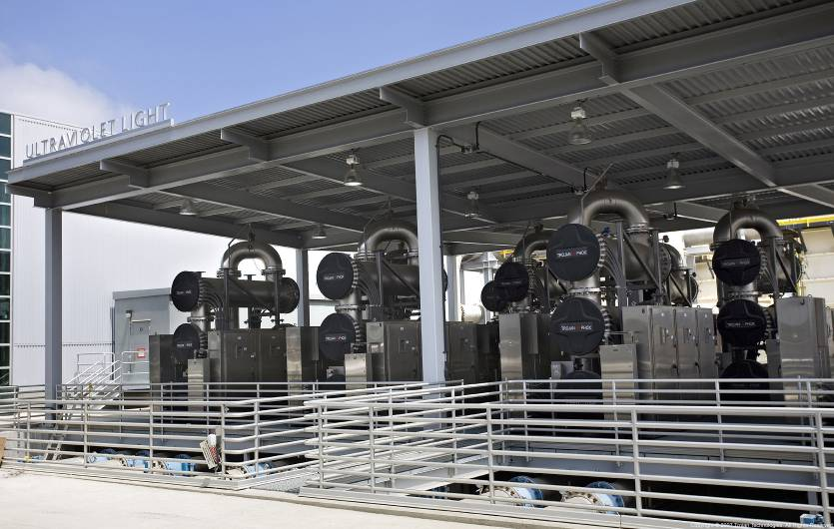
ORANGE COUNTY, CA – INDIRECT POTABLE REUSE (IPR)
Notes:
This is a graphic of the UV-Oxidation facility located in Orange County California
This facility provides 100 MGD of advanced treated wastewater (expanded from 70 MGD) that is re-injected into groundwater before treatment to drinking water

Slide 50
NDMA FULL SCALE TESTING - ORANGE COUNTY, CA
4 Reactors On
6 Reactors On
Flow: >8.5 MGD
Notes:
Like with the Bundamba plant, studies were carried out to demonstrate UV-Oxidation’s effectiveness against NDMA
Red bars show the NDMA in the INFLUENT
Grey bars show the NDMA in the EFFLUENT
As you can see UV-oxidation is very effective

Slide 51
WEST BASIN MUNICIPAL WATER DISTRICT, CA
12.5 MGD California facility also treating wastewater to drinking water standards for groundwater replenishment
MF/RO/UV-Oxidation treatment train (UV system uses monochromatic amalgam lamps)
1.3-log reduction of NDMA, disinfection
Notes:
The West Basin Municipal Water District in California is located near LAX airport in El Segundo, CA
It is designed to treat 12.5 MGD
Like the Orange County facility, it uses MF, RO and UV-Oxidation for the removal of molecular contaminants from wastewater, including NDMA

Slide 52
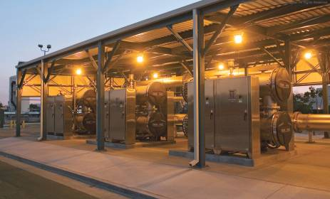
WEST BASIN MUNICIPAL WATER DISTRICT, CA
Notes:
The West Basin Municipal Water District in California is located near LAX airport in El Segundo, CA
It is designed to treat 12.5 MGD
Like the Orange County facility, it uses MF, RO and UV-Oxidation for the removal of molecular contaminants from wastewater, including NDMA

Slide 53
WEST BASIN MUNICIPAL WATER DISTRICT, CA – NDMA TREATMENT
Notes:
This figure shows the results of the demonstration study at the West Basin Municipal Water District
As you can see UV-Oxidation treatment resulted in an effluent concentration of NDMA of less than 5 ng/L compared to an influent concentration of over 120 ng/L (an over 95% reduction)

Slide 54
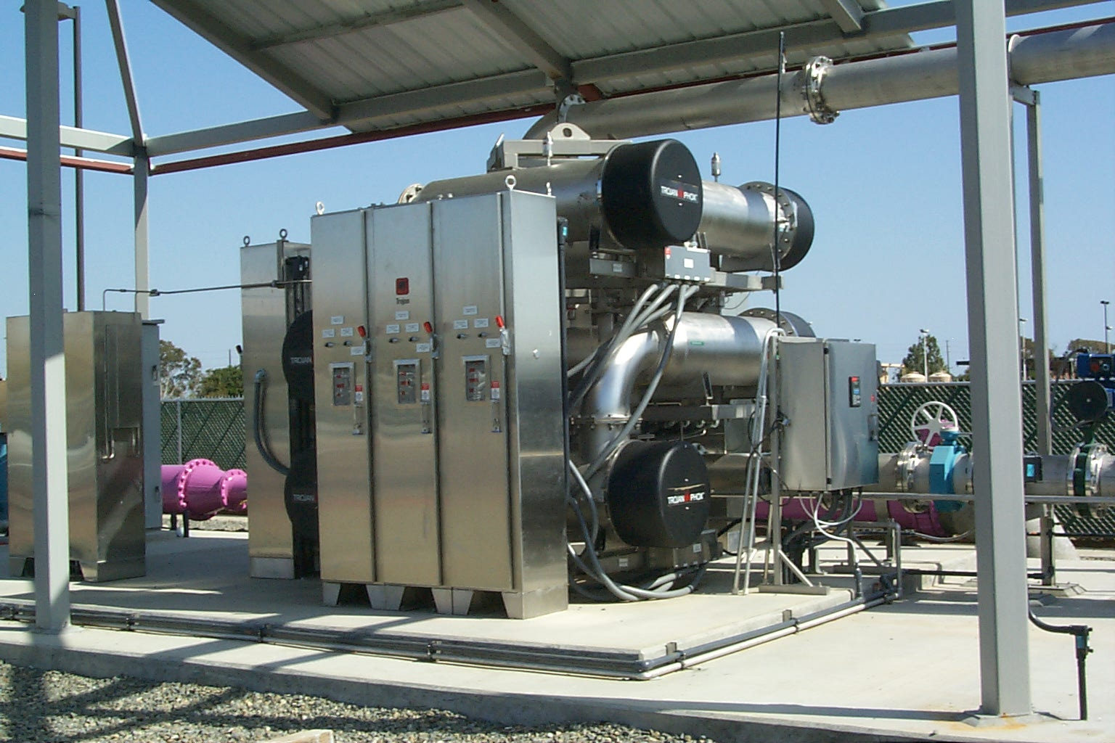
Leo J. Vander Lans Advanced Water Treatment Facility
LJVWTF began operation in 2005
Treating 3 million gallons/day (MGD)
UV design basis: 1.6-log reduction of NDMA

Slide 55
LVLWTF Expansion
Plant expansion to 8 MGD was completed in ‘14
2 new trains of UV added
Hydrogen peroxide injection system was added
Design: 2.1-log reduction of NDMA and 0.5-log reduction of 1,4-dioxane
Site acceptance testing required
UV/Cl₂ study performed in parallel

Slide 56
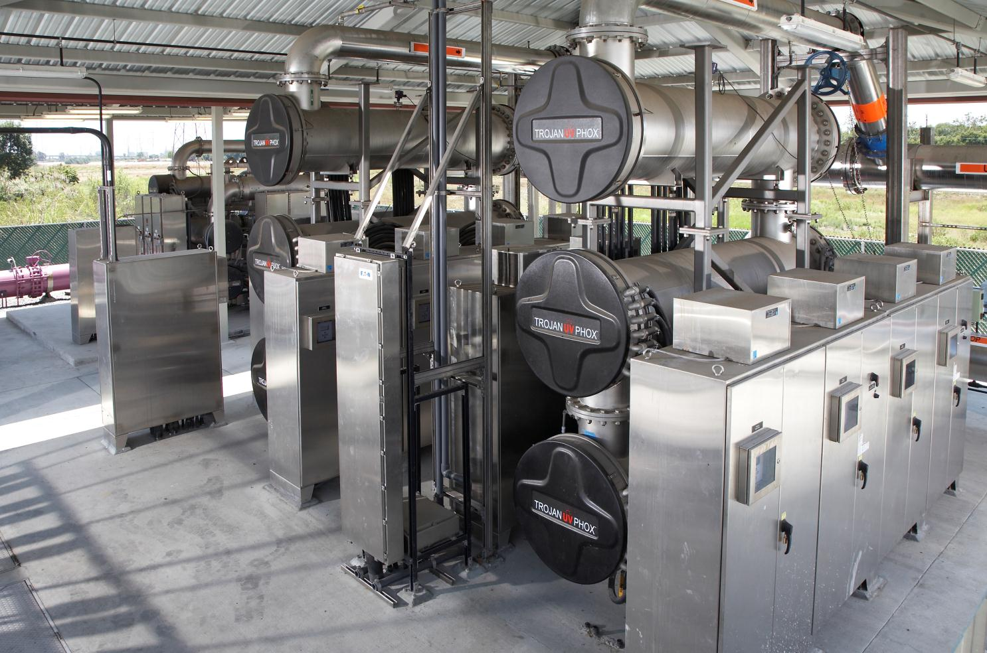
LVLWTF UV-Oxidation System

Slide 57

COLORADO RIVER MUNICIPAL WATER DISTRICT
Provides a privatized drinking water supply to municipalities in West Texas
  Odessa
  Snyder
  Big Spring
Population of service area = ~150,000
Traditional Sources of Raw Water:
  E.V. Spence Reservoir = 1.4 % FULL AS OF SEPT 8, 2014
  Lake J.B. Thomas= 0.9 % FULL AS OF SEPT 8, 2014
  O.H. Ivie Reservoir= 16.9 % FULL AS OF SEPT 8, 2014
Notes:
Lets focus on the CRMWD
Servicing 150K people
Traditionally drew on 3 existing reservoirs, over a large geographic spread

Slide 58
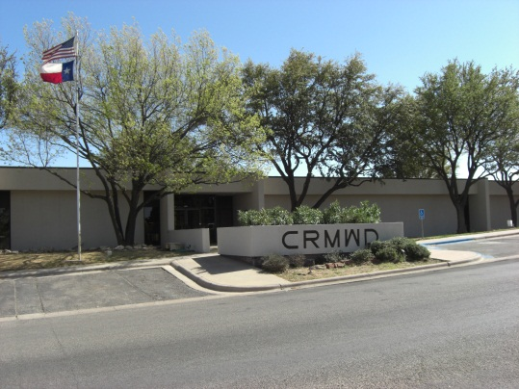
COLORADO RIVER MUNICIPAL WATER DISTRICT
In 2004, the traditional reservoirs used to supply drinking water were at only 10% of their capacity
In response to this as well as state mandated legislation to develop a long-term regional plan for drinking water supply, the CRMWD evaluated possible approaches to conserving or augmenting declining drinking water supplies.

Slide 59
COLORADO RIVER MUNICIPAL WATER DISTRICT
Evaluated options in the study included:
Use of other water catchments
Non-potable reuse of reclaimed wastewater
  Irrigation, Recreation, Agriculture
Potable reuse of reclaimed wastewater
  Drinking water
  Re-supply local reservoirs with high-purity treated wastewater

Slide 60
WHAT HAD BEEN DONE: OTHER EXTERNAL STUDIES
Evaluating alternatives to address water shortages in San Diego County
  Desal: Higher energy costs
  Non-potable reuse (Purple Pipe)
    Install new distribution system
  IPR: Low cost option
Notes:
This analysis shows the $/acre-foot for three well recognized methods for conserving drinking water supplies
This analysis was done for the city of San Diego
Desalination costs are generally higher to the extremely high energy requirements. In addition, there are always debates about the disposal of the RO brine
Purple pipe is a term used to describe the reuse of wastewater for non-potable purposes such as water golf courses and agricultural irrigation.
Purple pipe systems always require the installation of an exclusive distribution system for the reused water this can cost millions of dollars for each mile of pipe
In this analysis, the IPR cost includes the cost of transporting advanced treated wastewater ~10 miles to a reservoir for storage. Therefore, IPR cost shown here is slightly higher than what would be for equivalent large projects with a smaller transportation requirement.

Slide 61
SELECTING POTABLE vs. NON-POTABLE REUSE
Similar feasibility studies carried out in other areas
Cost ranges for various approaches to drinking water augmentation
Source: Fermanian Business & Economic Institute, 2010
Notes:
City of San Diego

Slide 62
SELECTING POTABLE vs. NON-POTABLE REUSE
CRMWD decided to build a single treatment plant that would treat secondary wastewater from surrounding communities to an “advanced” level
Known as the “Raw Water Production Facility” (RWPF)
The RWPF will generate “synthesized” raw water that will be BLENDED with “natural” surface raw water of the E.V. Spence Reservoir upstream of the local drinking water treatment facilities
Raw water will be re-treated as drinking water at existing drinking water treatment plants

Slide 63
THE FINAL SOLUTION
CRMWD Big Spring Reclamation Project

Slide 64
RWPF Plant Design Details and California Precedent
Advanced Treatment uses microfiltration, reverse osmosis and UV-oxidation similar to existing facilities in California; designed per CA regulations for Full Advanced Treatment
CA and Orange County GWRS precedent aids in Public Acceptance
UV-oxidation system sized based on treatment of NDMA and 1,4-Dioxane as surrogates
UV-oxidation serves a number of unique purposes
  Treatment of NDMA and 1,4-Dioxane
  Treatment of pharmaceuticals and endocrine-disrupting chemicals not removed by MF or RO
  Additional disinfection barrier of 4-log virus credit
Raw Water Production Facility Design Parameters
Design Flow: | 1.8 MGD
Target Contaminants: | NDMA 1,4-Dioxane
Design NDMA Reduction: | 1.2 - Log
Design 1,4-Dioxane: | 0.5 - Log
Oxidant: | H₂O₂
Disinfection Method: | UV Light

Slide 65
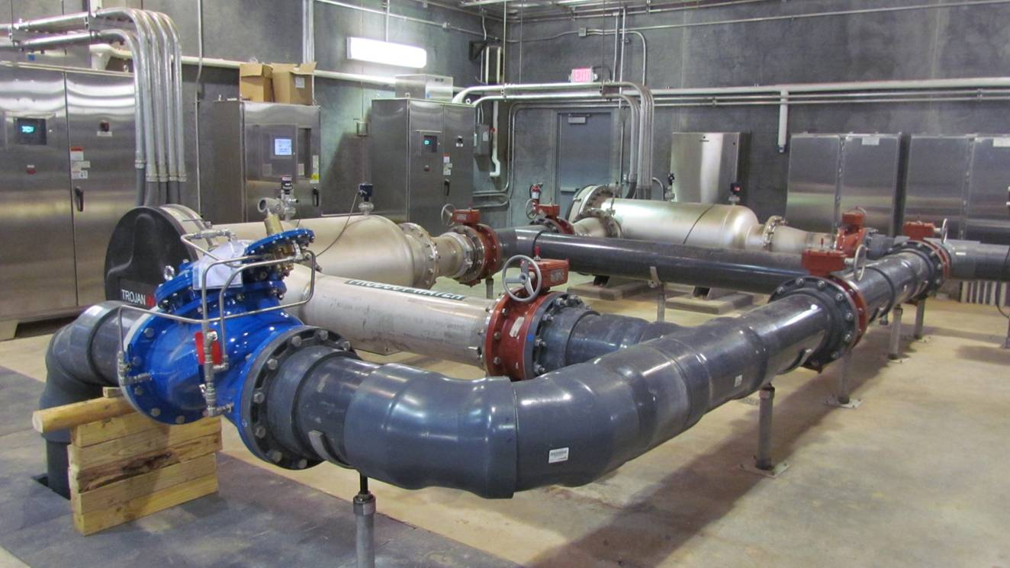
THE FINAL SOLUTION – BIG SPRING

Slide 66
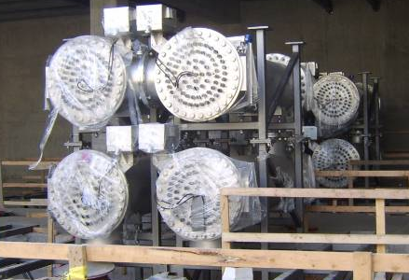
DRINKING WATER TREATMENT IN MDW AURORA, CO
190 MLD Colorado facility treating drinking water obtained from an effluent-dominated source
Platte River receives significant wastewater discharge
Treatment Process: Bank filtration, Precipitative softening, TrojanUVPhox™ UV-Oxidation, Biological filtration, Granular activated carbon
No membranes = no discharge, destruction technology
Use of LPHO technology significantly reduces energy vs. MP

Slide 67
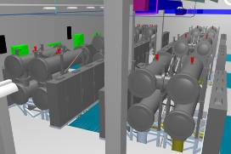
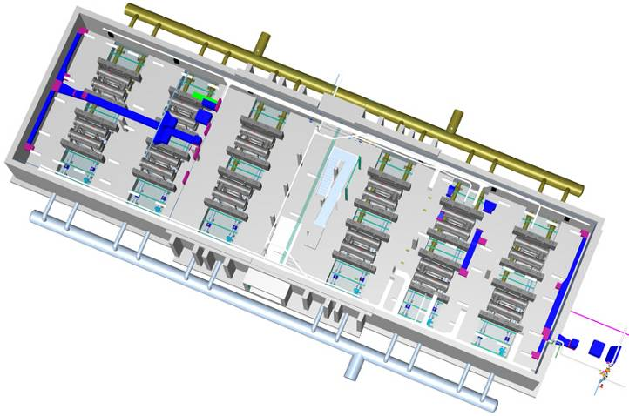
MDW INSTALLATION - AURORA, CO

Slide 68
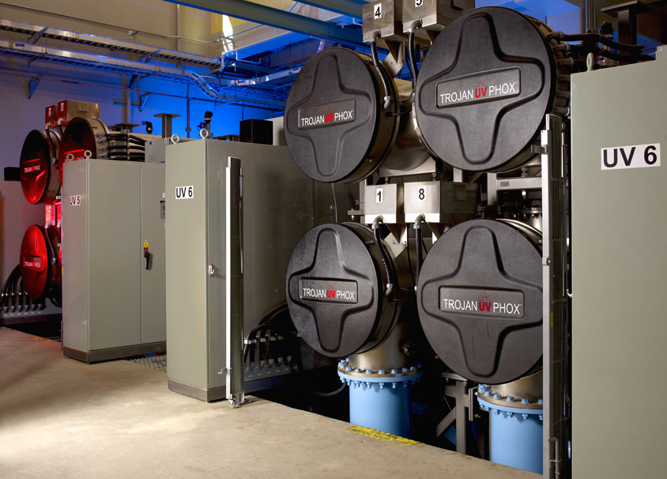
MDW INSTALLATION - AURORA, CO

Slide 69
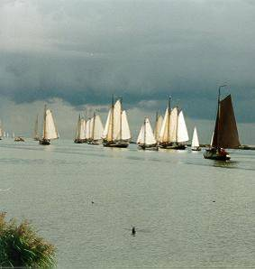
MULTI-BARRIER APPROACH – PWN: ANDIJK DRINKING WATER PLANT
Water source is Lake IJssel in North Holland
Fed by Rhine River; significant amount of contaminants (from wastewater, agriculture, etc)
UV-Oxidation a barrier to micropollutants (pesticides, pharmaceuticals, seasonal algae-related contaminants, T&O compounds etc.)
Disinfection objective to reduce Spores of Sulfur Reducing Clostridia (SSRC) and Cryptosporidium & Giardia
Serves ~500,000 people (Peak flow ~95 MLD)

Slide 70
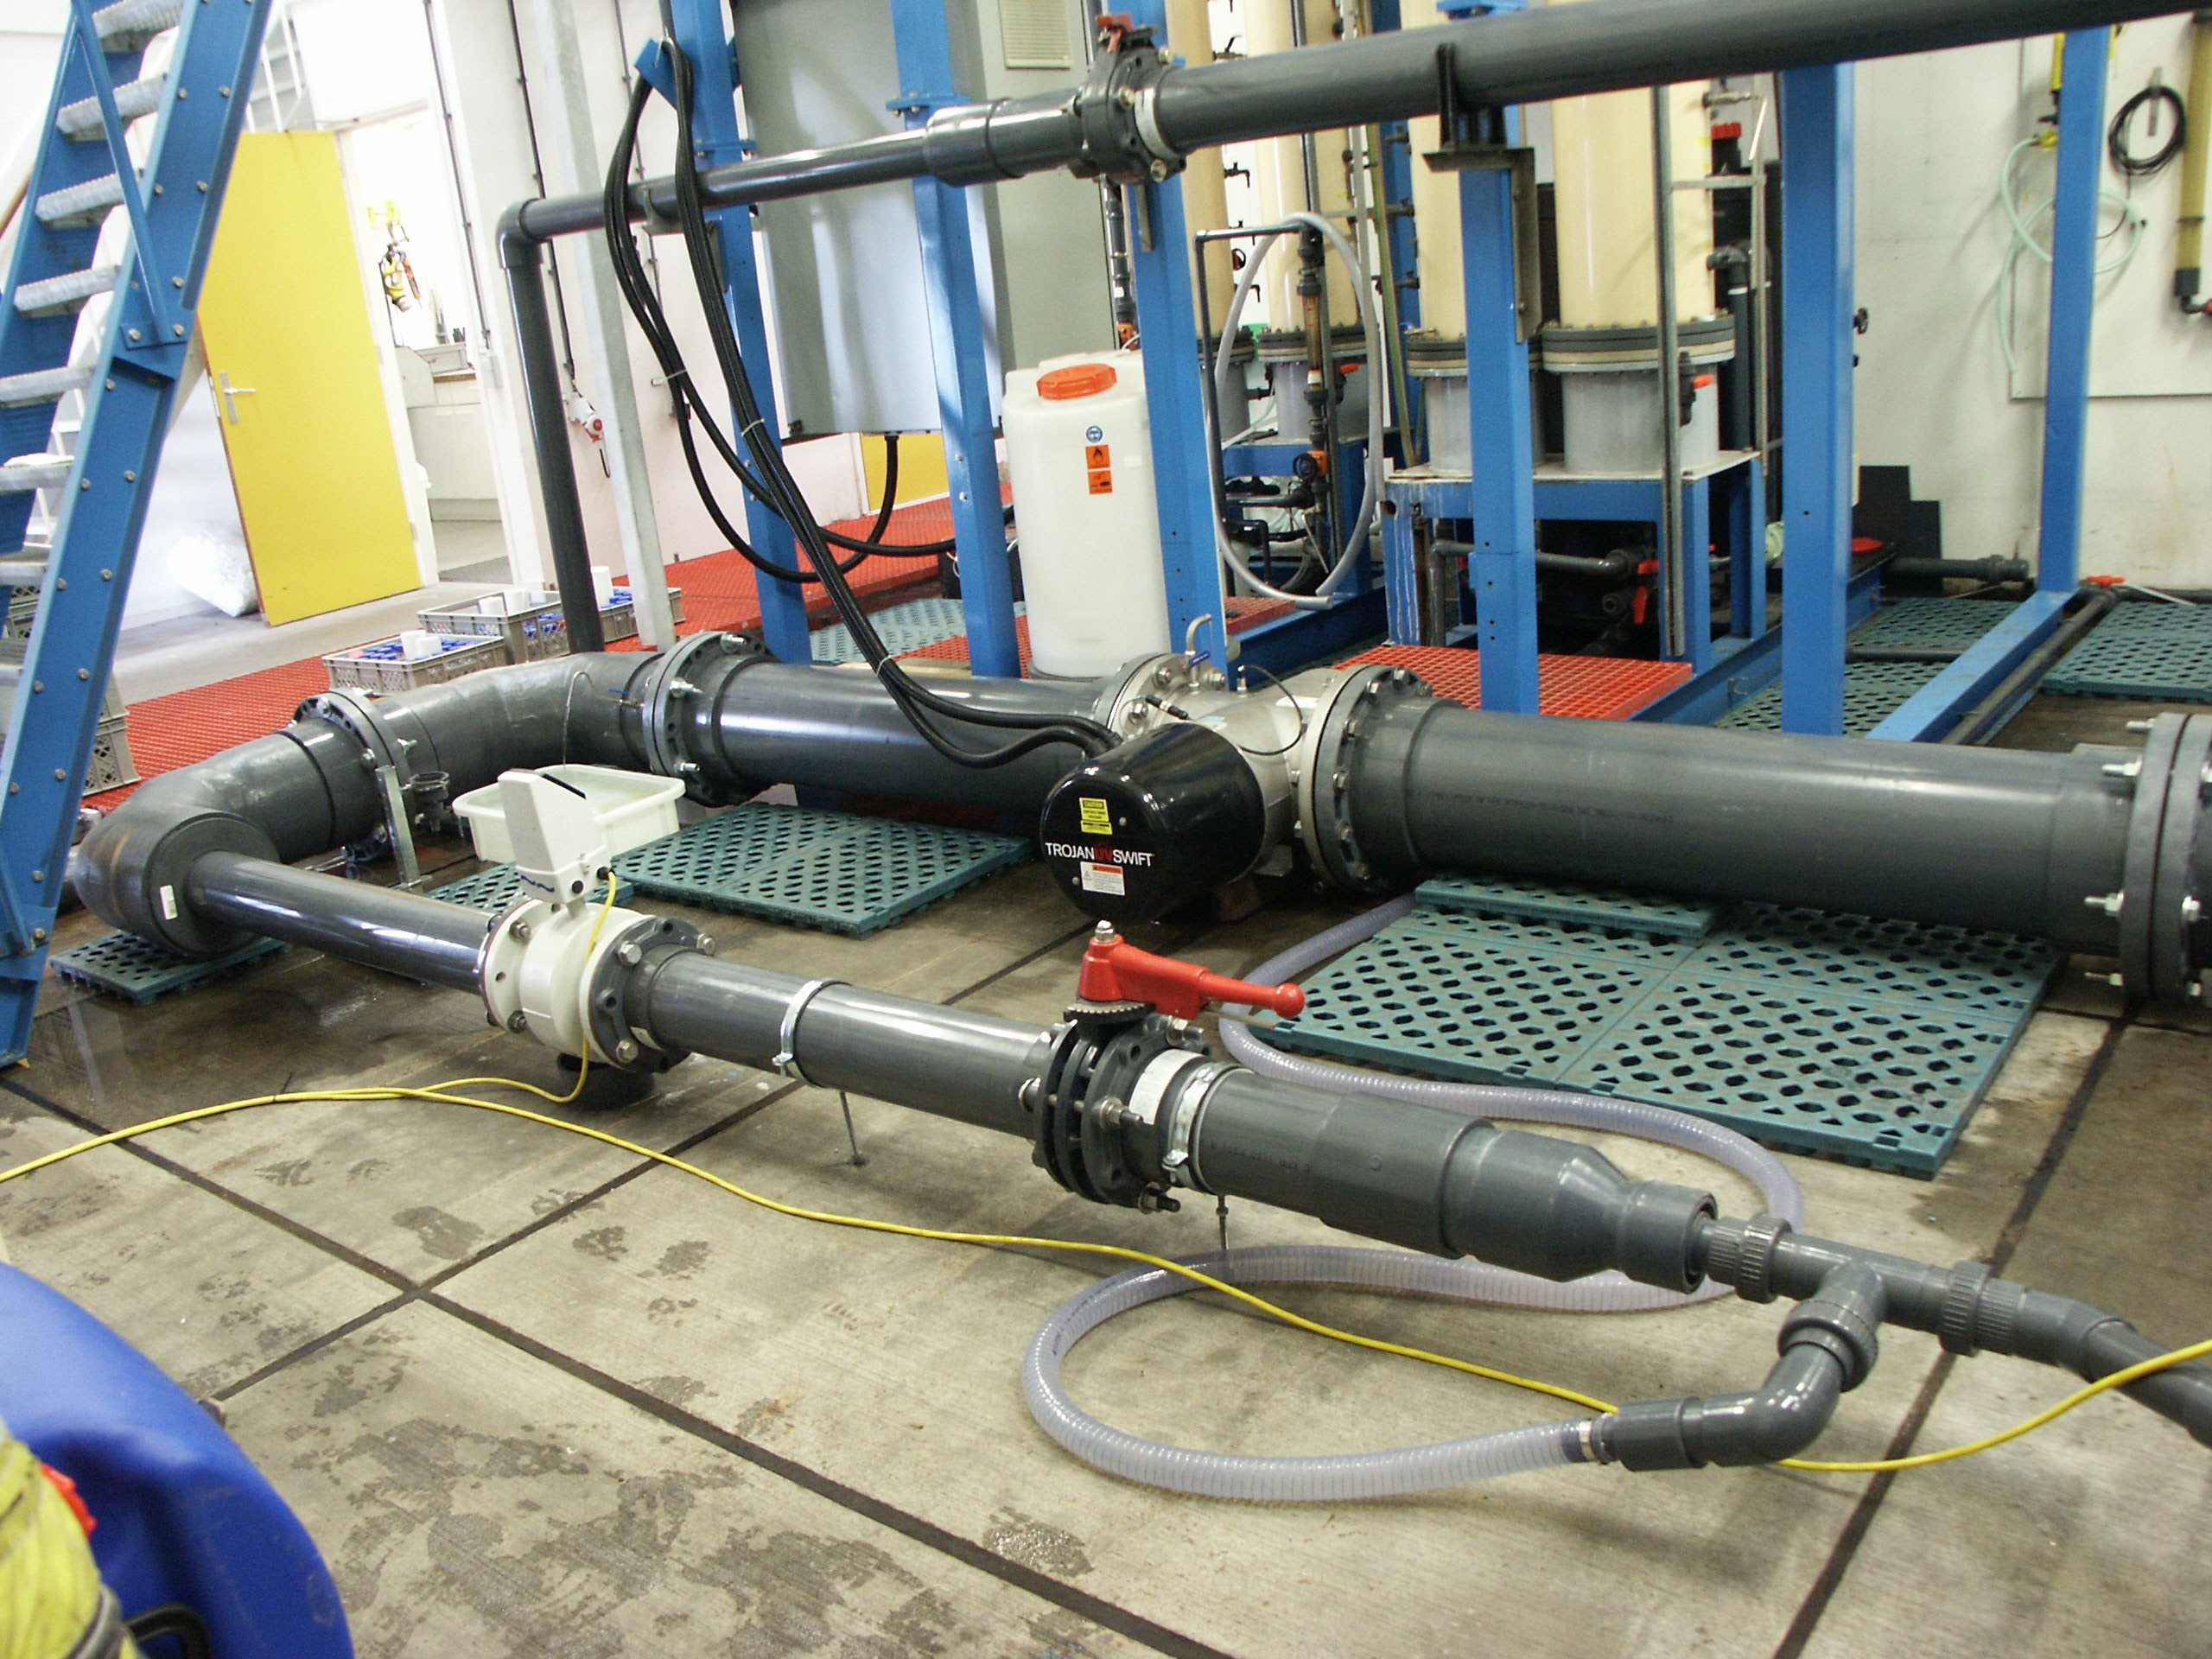
PWN ANDIJK – UV OXIDATION & DISINFECTION
Ozone considered but rejected due to inability to treat targeted compounds and bromate DBP concerns
UV-Oxidation does not create bromate
Joint research project between Trojan & PWN investigated UV-oxidation and optimized reactor design
Involved laboratory & pilot plant work
Full scale UV-Oxidation plant installed October 2004.
Heemskerk (another PWN Water Treatment Plant) with same treatment objectives constructed in 2008

Slide 71
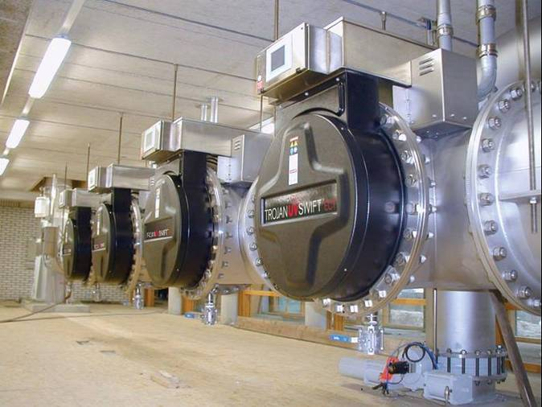
FULL-SCALE INSTALLATION AT ANDIJK
TrojanUVSwift™ECT installation in Andijk (1 train of 3 trains)

Slide 72
PWN RESULTS FOR PESTICIDE TREATMENT
Notes:
Peter- I would just explain briefly what the left axis is – probably not important to go into too much detail on EEO. I deleted the slide that describes EEO earlier to save time during your presentation.

Slide 73
CONCLUSIONS
Potable reuse can be much less expensive than non-potable reuse
  Year-round drinking water supply
  Sustainable supply
  Various economic and cost advantages over alternatives
Advanced treatment of wastewater included MF-RO-UV-oxidation treatment train
  Multi-barrier strategy
  UV-Oxidation treats contaminants of concern not removed by RO (E.g.. NDMA)
  Design based on extensive precedents in California, elsewhere

Slide 74



Thank you
Adam D. Festger
Reuse Business Development Manager
Trojan UV
afestger@trojanuv.com
Notes:
End slide

