Slide 1




Slide 2
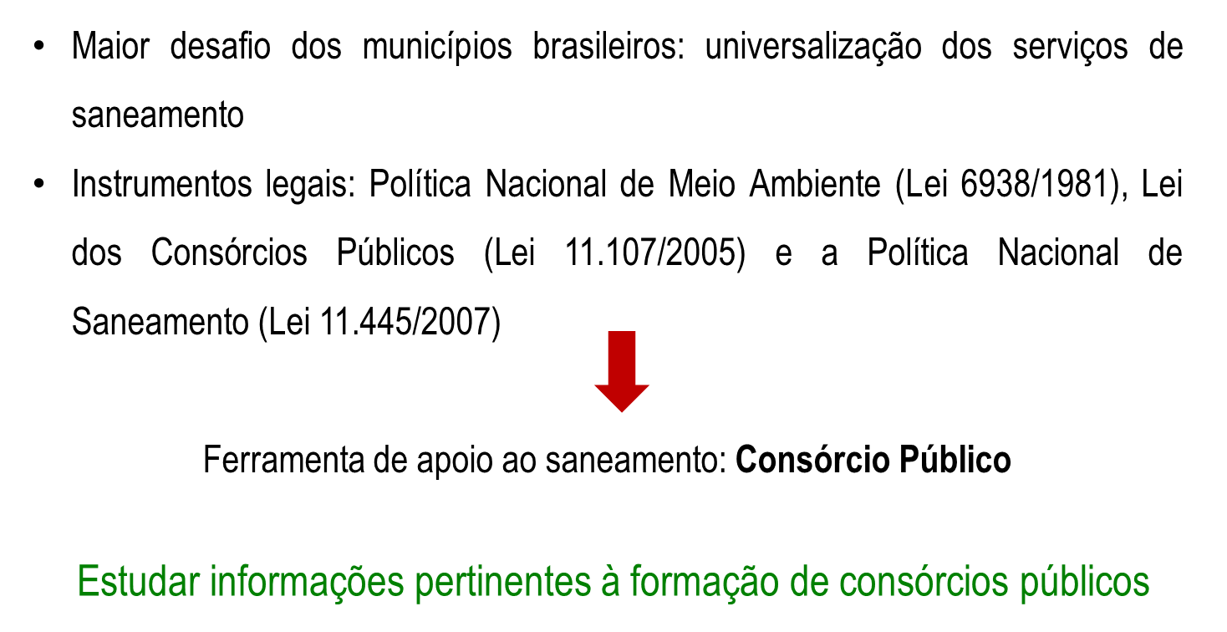
INTRODUÇÃO
(PEARCE, D.M. & TURNER, R.K, Economics of natural resources and the environment, Johns Hopkins, EUA, 1991.)
(PEARCE, D.M. & TURNER, R.K, Economics of natural resources and the environment, Johns Hopkins, EUA, 1991.)
(PEARCE, D.M. & TURNER, R.K, Economics of natural resources and the environment, Johns Hopkins, EUA, 1991.)

Slide 3
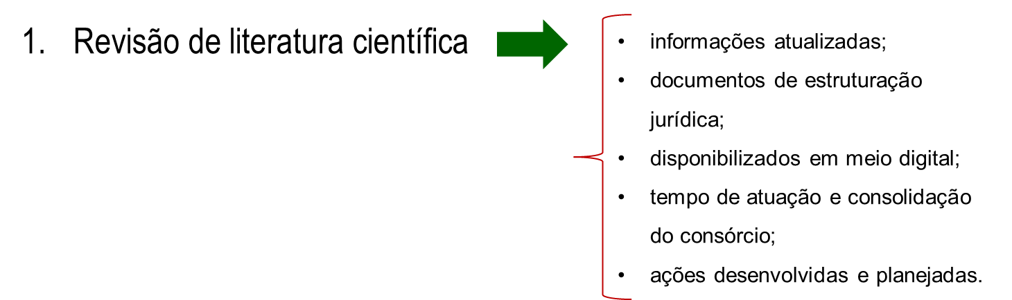

METODOLOGIA
(PEARCE, D.M. & TURNER, R.K, Economics of natural resources and the environment, Johns Hopkins, EUA, 1991.)

Slide 4

RESULTADOS

Slide 5

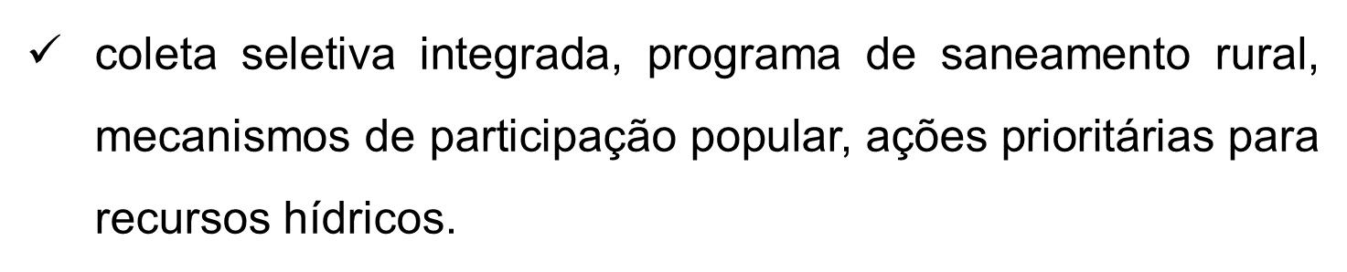
RESULTADOS

Slide 6


RESULTADOS

Slide 7
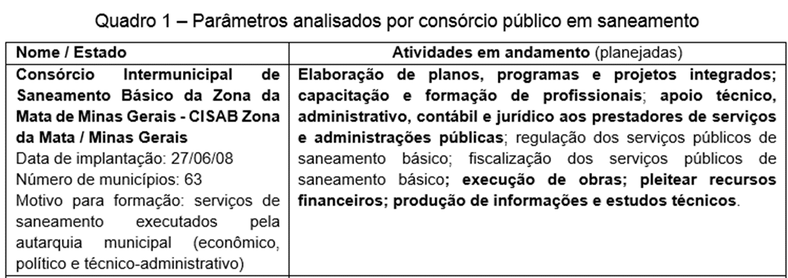
RESULTADOS

Slide 8
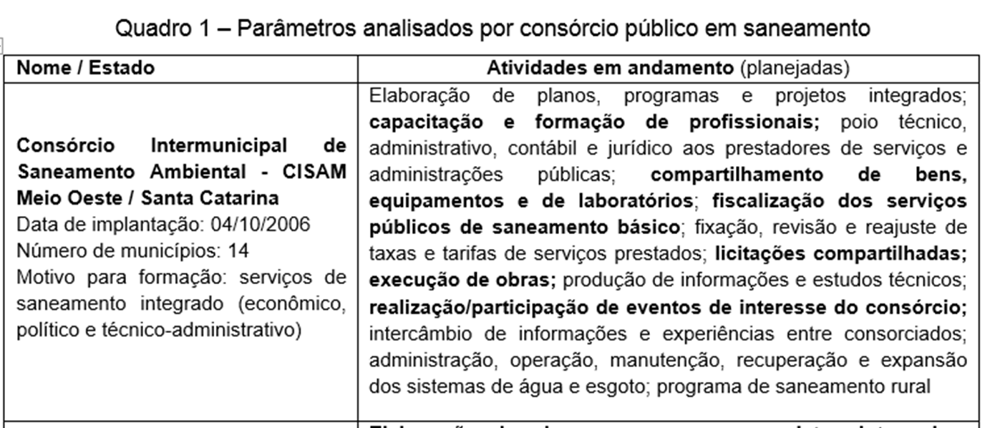
RESULTADOS

Slide 9
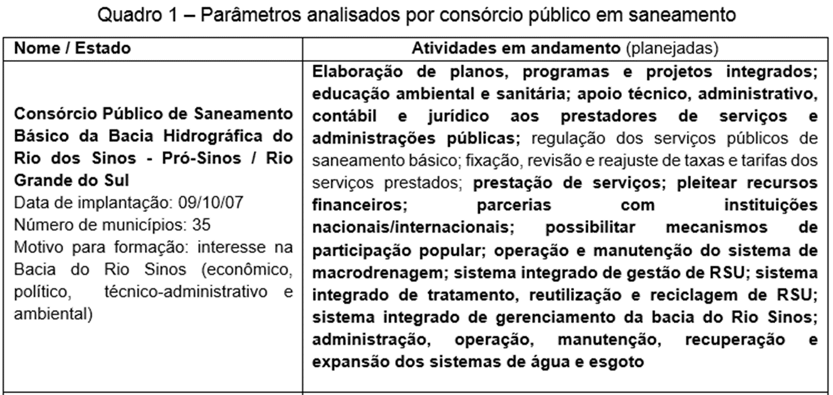
RESULTADOS

Slide 10
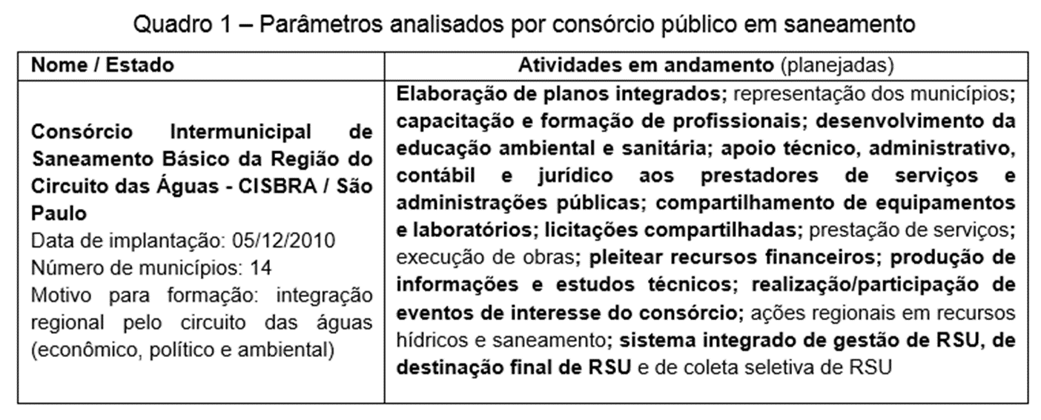
RESULTADOS

Slide 11
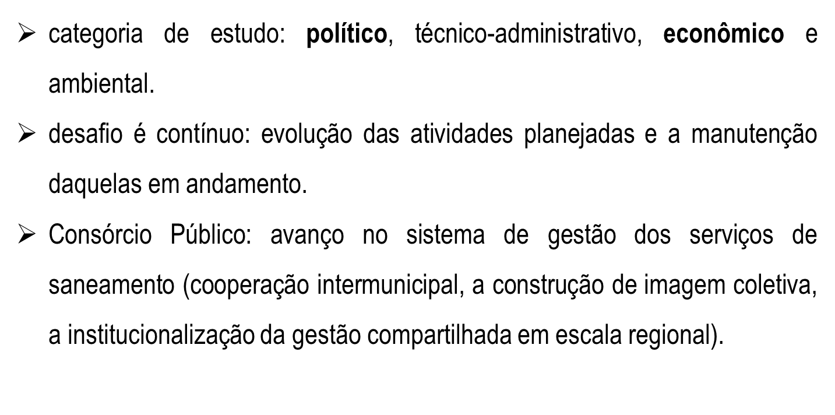
RESULTADOS

Slide 12
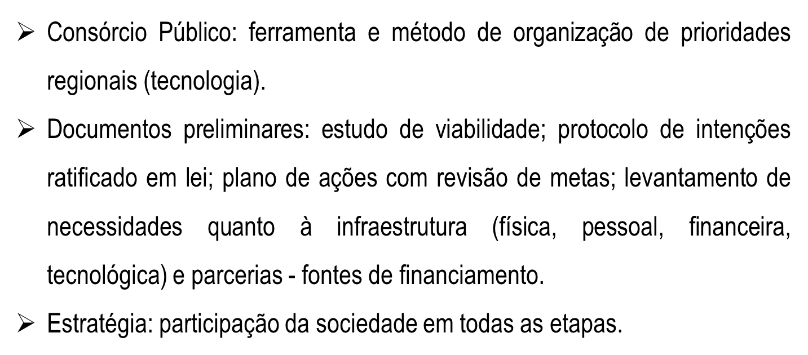
CONCLUSÕES

Slide 13
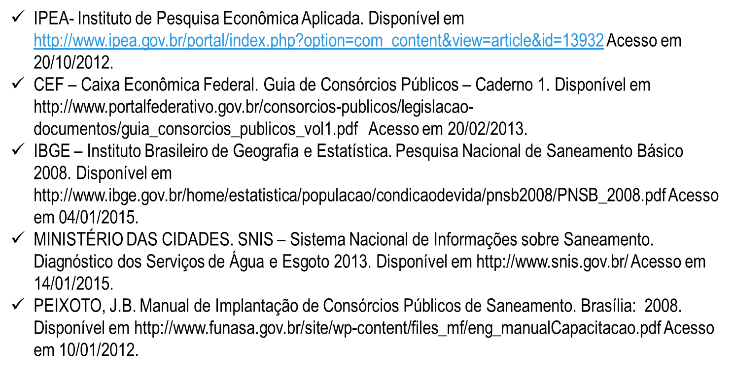
REFERÊNCIAS
(PEARCE, D.M. & TURNER, R.K, Economics of natural resources and the environment, Johns Hopkins, EUA, 1991.)
(PEARCE, D.M. & TURNER, R.K, Economics of natural resources and the environment, Johns Hopkins, EUA, 1991.)
(PEARCE, D.M. & TURNER, R.K, Economics of natural resources and the environment, Johns Hopkins, EUA, 1991.)

Slide 14

(PEARCE, D.M. & TURNER, R.K, Economics of natural resources and the environment, Johns Hopkins, EUA, 1991.)
(PEARCE, D.M. & TURNER, R.K, Economics of natural resources and the environment, Johns Hopkins, EUA, 1991.)
(PEARCE, D.M. & TURNER, R.K, Economics of natural resources and the environment, Johns Hopkins, EUA, 1991.)

